Slide 1
Newburgh Primary School

Slide 2
Newburgh Primary School Values
Nurturing
Engaged
Welcoming to everyone
Be considerate
Unique
Resilient
Great achievers
Happy and Healthy

Slide 3
Consideration
Our one school rule

Slide 5
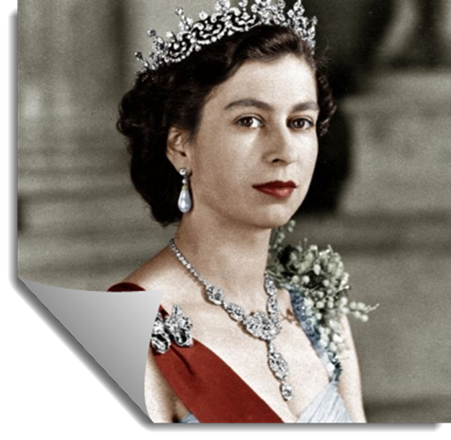
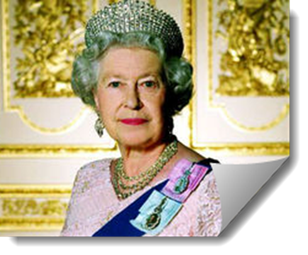
On 6th February 1952
Princess Elizabeth became Queen Elizabeth 11.

Slide 6
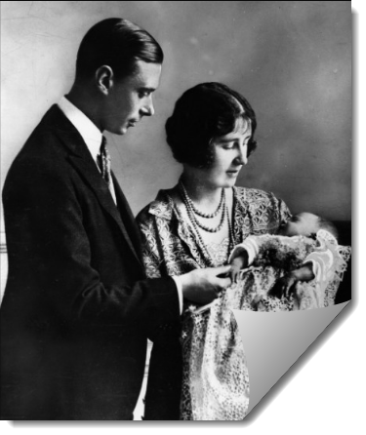
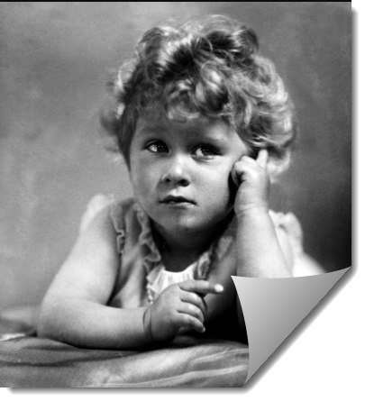
Princess Elizabeth was born on 21st April, 1926 in London.
Elizabeth’s father would later become King George V1.

Slide 7
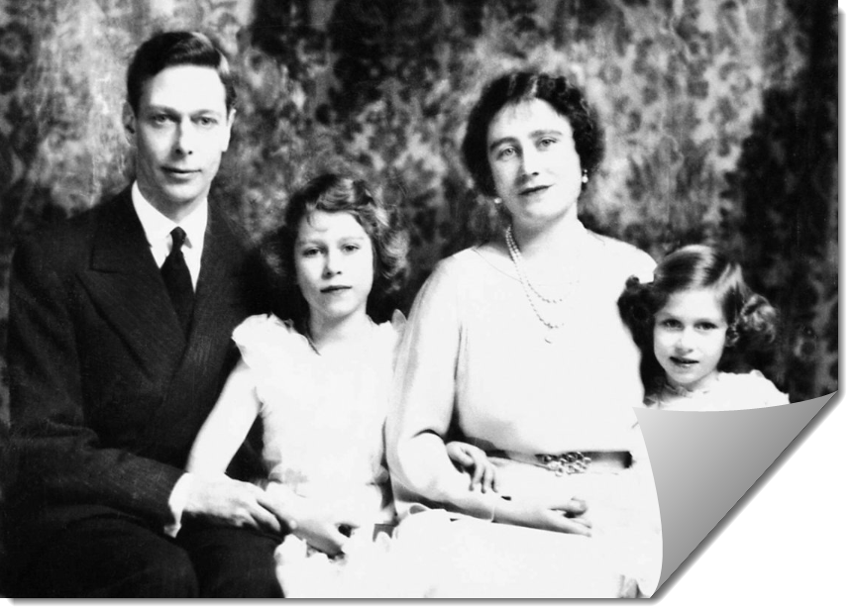
Princess Elizabeth enjoyed a carefree childhood and in 1936, when she was ten, her father was crowned King George V1 and she knew that one day she would be Queen.

Slide 8
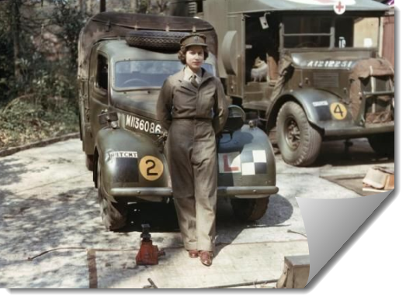
In 1939 World War 11 broke out and in 1945 Princess Elizabeth joined the Auxiliary Territorial Service (ATS) as a volunteer.

Slide 9
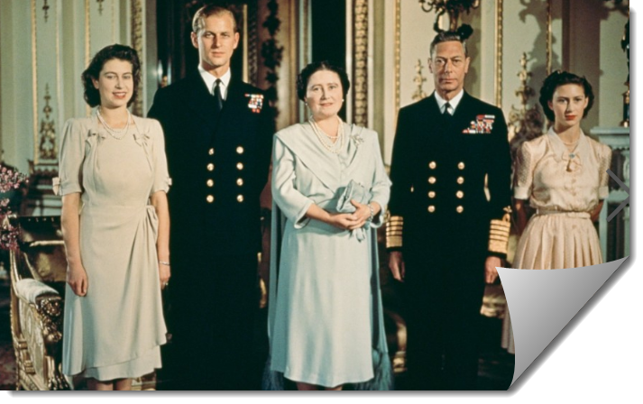
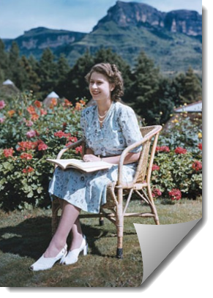
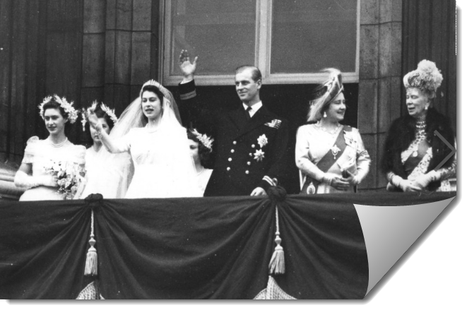
Princess Elizabeth visited South Africa, on 21st April, 1947, on her 21st birthday. In the same year she became engaged and married to Prince Philip of Greece.

Slide 10
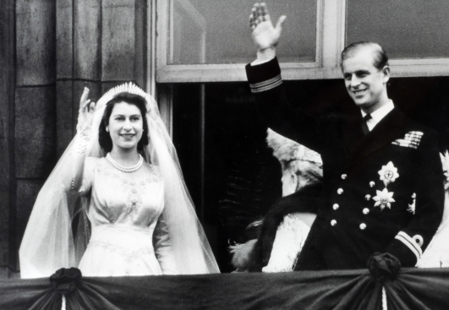
The Wedding
Prince Philip and Princess Elizabeth were married on 20 November 1947. On this day he became Duke of Edinburgh.

Slide 11
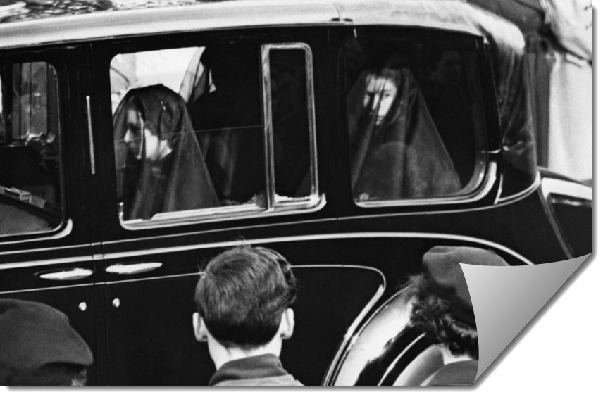
On 6th February, 1952, when she was on an African tour, she was told the sad news that her father had died.
She was just 25 and flew back to England as Queen.

Slide 12
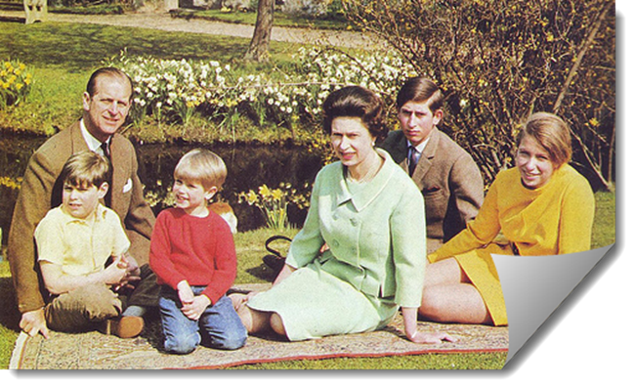
The Queen and Prince Philip had four children, Prince Charles, Princess Anne, Prince Andrew and Prince Edward.
Monday 14th Jan
Thursday 24th Jan
Monday 28th Jan
w/k 4th February-No Staff Meeting
Thursday 14th February
Wednesday 27th February 3:45 to 5:15pm
Monday 4th March
Thursday 14th March
Monday 18th March
Thursday 28th March
Monday 1st April
w/k 8th April No Staff Meeting

Slide 13
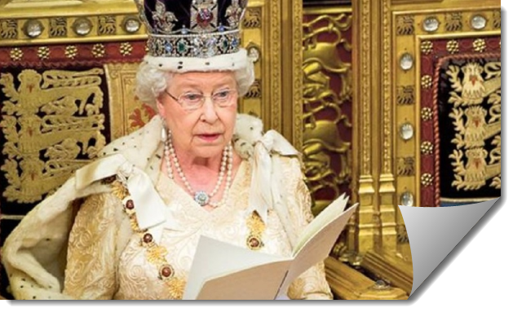
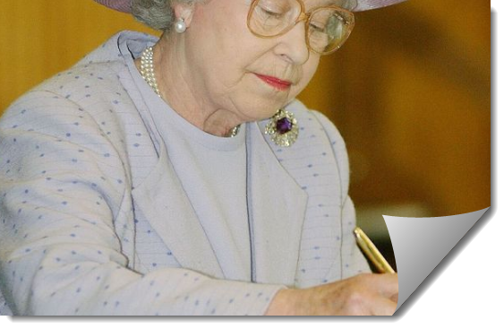
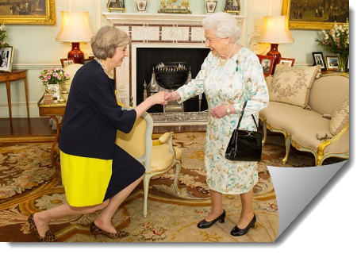
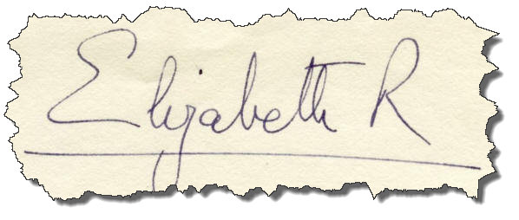
The Queen has to perform many duties because she is Head of State. She has to read and sign documents, attend important ceremonies and meet regularly with the Prime Minister.

Slide 14
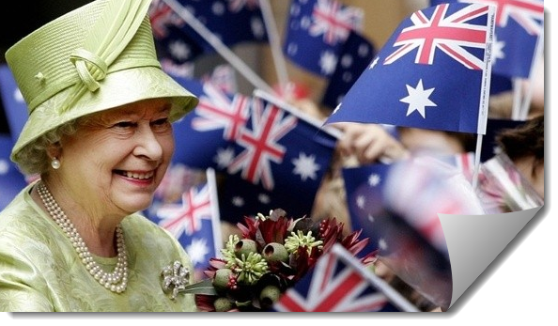
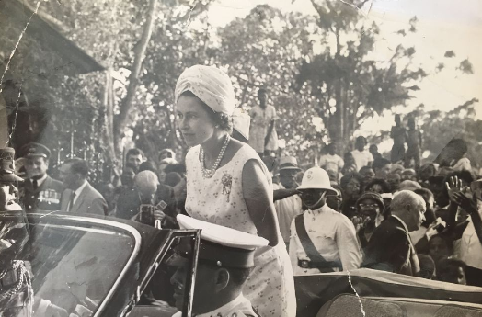
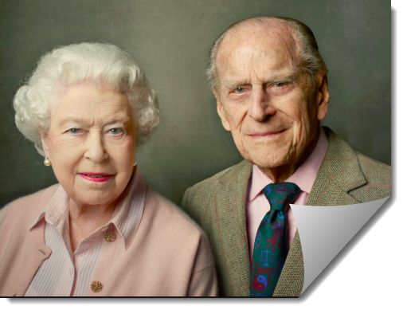
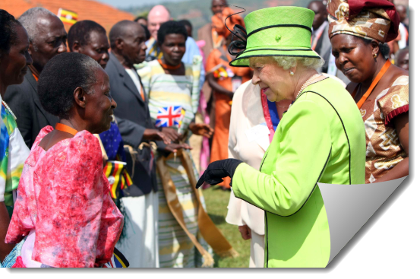
Often with Prince Philip by her side, the Queen has visited more than 120 countries around the world.

Slide 15
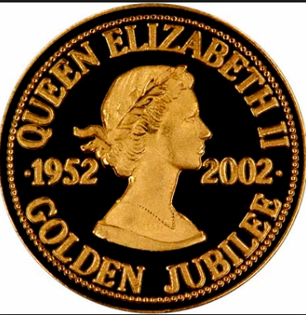
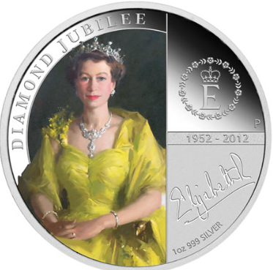
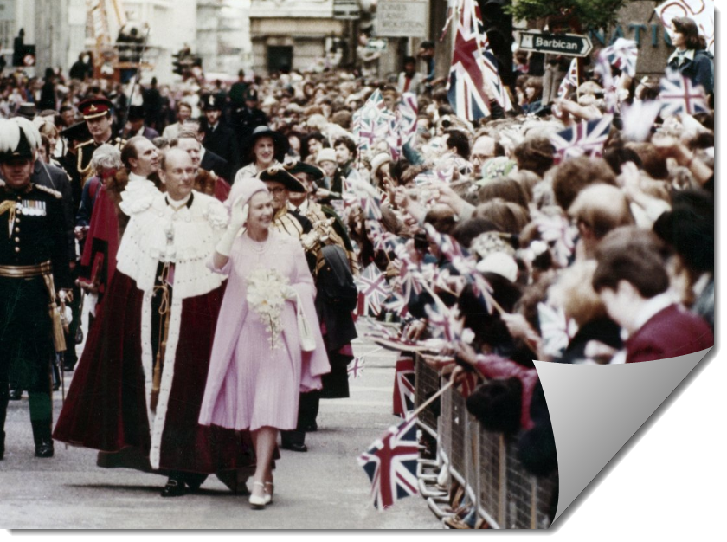
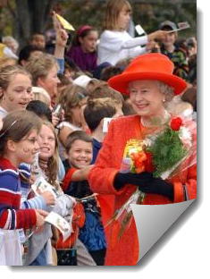
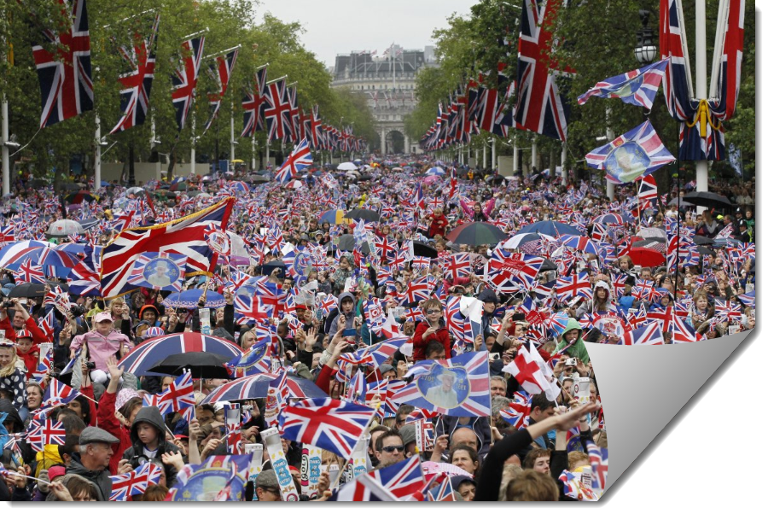
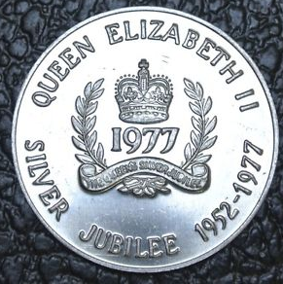
The Queen has celebrated many happy events; a Silver Jubilee in 1977 (25 years on the throne), a Golden Jubilee in 2002 (50 years on the throne) and a Diamond Jubilee in 2012 celebrating 60 years on the throne.
1977
2002
2012

Slide 16
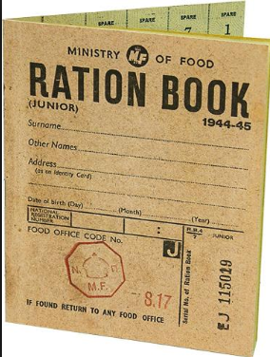
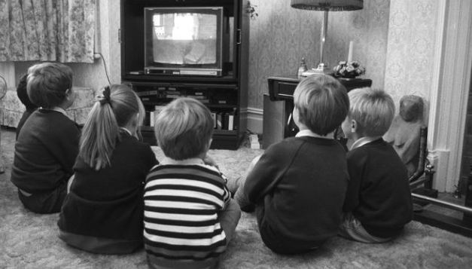
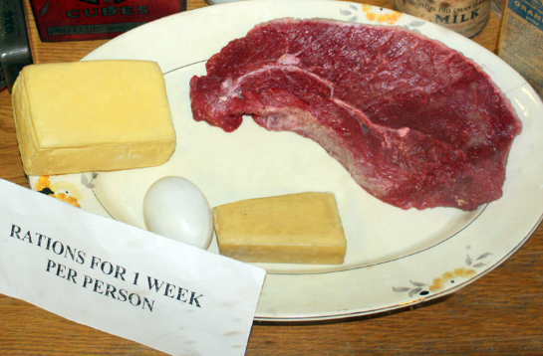
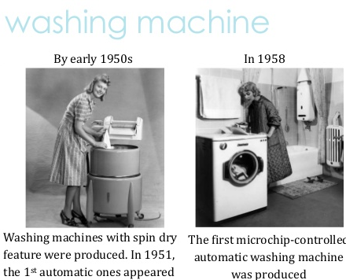
The Queen has reigned through over 60 years of change.
World War 11
rationing
New things were invented; radiograms, washing machines, cookers and fridges and television sets!

Slide 17
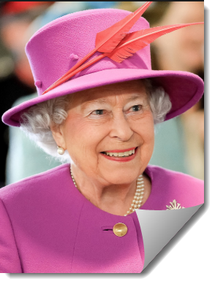
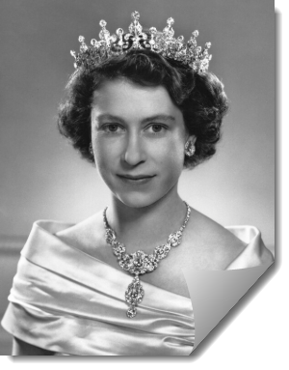
Queen Elizabeth 11 has ruled for longer than any other Monarch in British history.

Slide 18
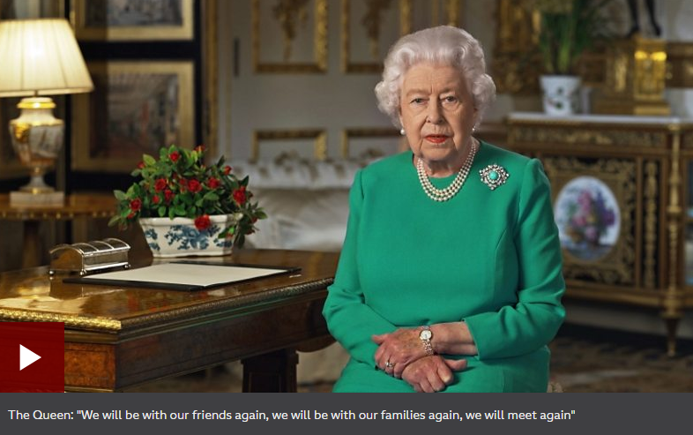
April 2020 – The Queen addresses the nation and encourages everyone during the pandemic.

Slide 19
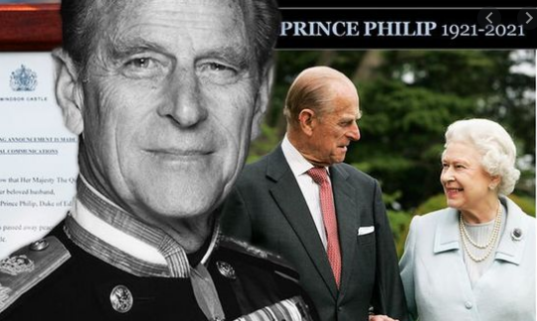
On the 9th April 2021 – The Duke of Edinburgh died.

Slide 20
God save our gracious Queen! Long live our noble Queen! God save the Queen! Send her victorious, Happy and glorious, Long to reign over us, God save the Queen.
Thy choicest gifts in store On her be pleased to pour, Long may she reign. May she defend our laws, And ever give us cause, To sing with heart and voice, God save the Queen.
The British National Anthem is a song called
'God Save The Queen‘.

