Slide 1
Newburgh Primary School

Slide 2
Newburgh Primary School Values
Nurturing
Engaged
Welcoming to everyone
Be considerate
Unique
Resilient
Great achievers
Happy and Healthy

Slide 3
GETTING ACTIVE
いっしょに運動しよう | ISSHONI UNDŌ SHIYŌ
TRAVEL TO TOKYO
GET HAPPY! MAKING ME HAPPY PRESENTATION
AND ACTIVITIES
WELCOME |ようこそ | YŌKOSO
HAVING FUN
たのしもう | TANOSHIMŌ
TRYING NEW THINGS
やってみよう | YATTE MIYŌ
getset.co.uk/travel-tokyo
#TravelToTokyo

Slide 4
WHAT DOES HAPPINESS MEAN TO YOU?
For example:
Having fun
Being in a good mood
Thinking positively
Feeling good about yourself
Enjoying time with others
Appreciating life/the world
Notes:
DEFINING HAPPINESS – pair and share activity
Show pupils the smiley face.
In pairs, ask them to share what ‘happiness’ means to them. Feed back some examples to the whole group.
Reveal the examples on the slide: reinforce the holistic nature of happiness, i.e. self/others/the world; recognise it is about heart (feelings) and head (thoughts).

Slide 5
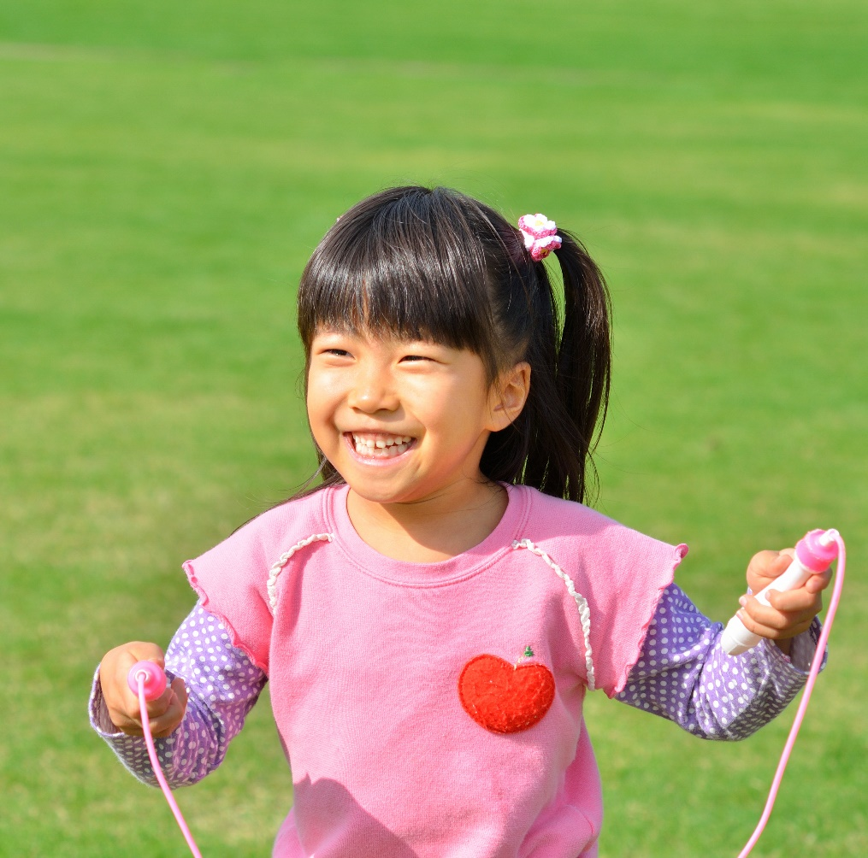
WHAT DOES HAPPINESS MEAN IN JAPAN?
Happiness in living
いきがい
Ikigai
Reason to get up in the morning
LIFE
+
VALUE
Notes:
DEFINING HAPPINESS IN JAPAN – information
Share the Japanese word: Ikigai (ik-i-gai)
There is no direct English translation but broadly it means ‘happiness in living’.
It comes from two words: Iki (life) and Gai (value or worth), i.e. what makes life worth living or, more simply, what gives Japanese people a reason to get up in the morning.

Slide 6
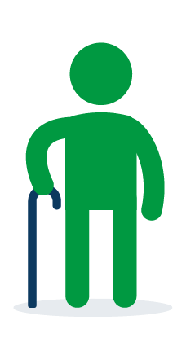
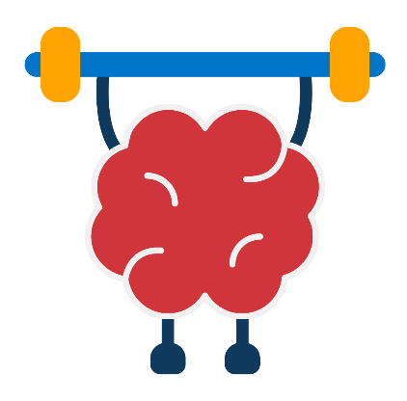
WHAT ARE THE BENEFITS OF IKIGAI?
Match the phrase to the correct picture.
A
B
C
D
Live well for longer
Mentally and emotionally healthy (wellbeing)
Physically healthy
Active mind (achieve in school)
Notes:
IDENTIFYING THE BENEFITS OF IKIGAI (HAPPINESS) – active matching activity
Show the four pictures on the slide.
Label the corners of the room: A, B, C, D to match the pictures.
In turn, reveal each of the word labels and ask pupils to move to the matching picture corner.
Click again to reveal the answers.
Alternatively, allocate each pupil a word label, i.e. 1 = physically healthy. On go, pupils move to their matching picture corner.
To increase the challenge (or use a non-active method), ask pupils to identify the pictures without showing (or moving to) the matching labels.

Slide 7
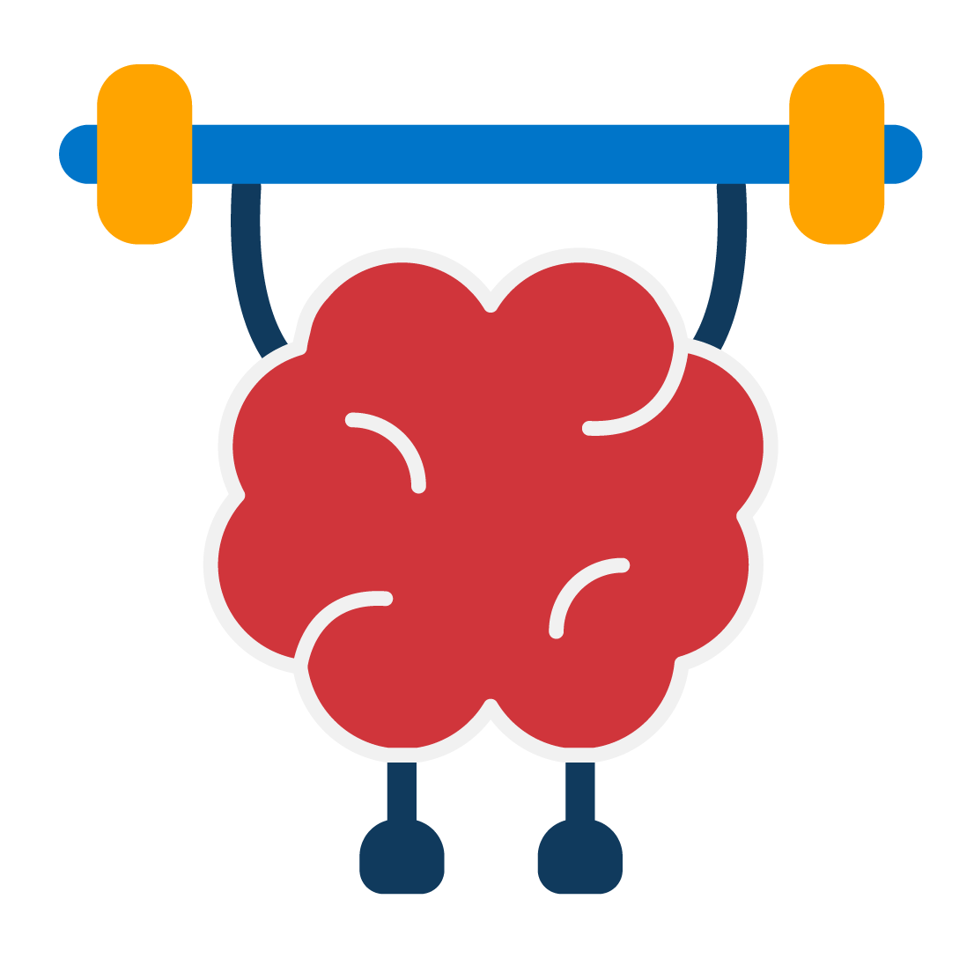
WHAT ARE THE BENEFITS OF IKIGAI?
Match the phrase to the correct picture.
A
B
C
D
Active mind (achieve in school)
Physically healthy
Mentally and emotionally healthy (wellbeing)
Live well for longer
Notes:
IDENTIFYING THE BENEFITS OF IKIGAI (HAPPINESS) – active matching activity
Show the four pictures on the slide.
Label the corners of the room: A, B, C, D to match the pictures.
In turn, reveal each of the word labels and ask pupils to move to the matching picture corner.
Click again to reveal the answers.
Alternatively, allocate each pupil a word label, i.e. 1 = physically healthy. On go, pupils move to their matching picture corner.
To increase the challenge (or use a non-active method), ask pupils to identify the pictures without showing (or moving to) the matching labels.

Slide 8
CHANGING HOW HAPPY YOU ARE
Japanese people believe:
Ikigai
=
“Japanese people believe that the sum of small joys
in everyday life results in a more fulfilling life as a whole.”
(Akihiro Hasegawa)
PURPOSE
+
ACTION
Notes:
CHANGING HOW HAPPY YOU ARE – information
Research by Akihiro Hasegawa (2001) – a clinical psychologist – found that Japanese people believe happiness in life comes from the sum of small joys. This means you can still have ikigai – and look forward to things – even if you are having a sad moment.
They also believe that it isn’t enough to value or have a purpose in life; ikigai comes from putting those values and that sense of purpose into action.

Slide 9
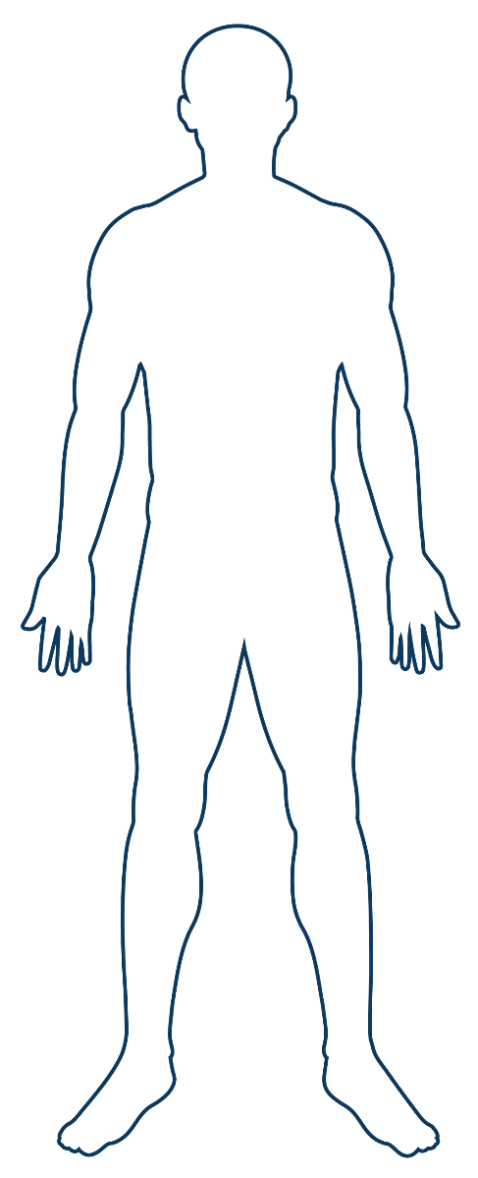
HOW MUCH CAN YOU CONTROL HOW HAPPY YOU ARE?
100%
40%
75%
Choices/actions
50%
10%
What affects happiness?
Circumstances
25%
50%
Genetics
0%
Notes:
CHANGING HOW HAPPY YOU ARE – activity
Ask pupils to stand up. Explain they will show the answer (the percentage) by touching the relevant part of their bodies:
Head – 100%
Shoulders – 75%
Waist – 50%
Knees – 25%
Toes – 0%
Ask them to decide to what extent they can influence (change) how happy they are (as opposed to other factors/influences).
On ‘go’, pupils show by touching the relevant body part.
Show the bar chart to show the facts (data from Action for Happiness).
Our genes have an approx. 50% influence on how happy we are (some people are naturally happier than others).
External circumstances only have approx. 10% influence (e.g. income, environment, etc.)
Our choices and actions (behaviours) have approx. 40% influence – therefore we CAN make choices/take actions to affect our happiness.
Emphasise that pupils can’t control everything they feel, but they can make some difference: they can act; they’re not just passive beings.

Slide 10
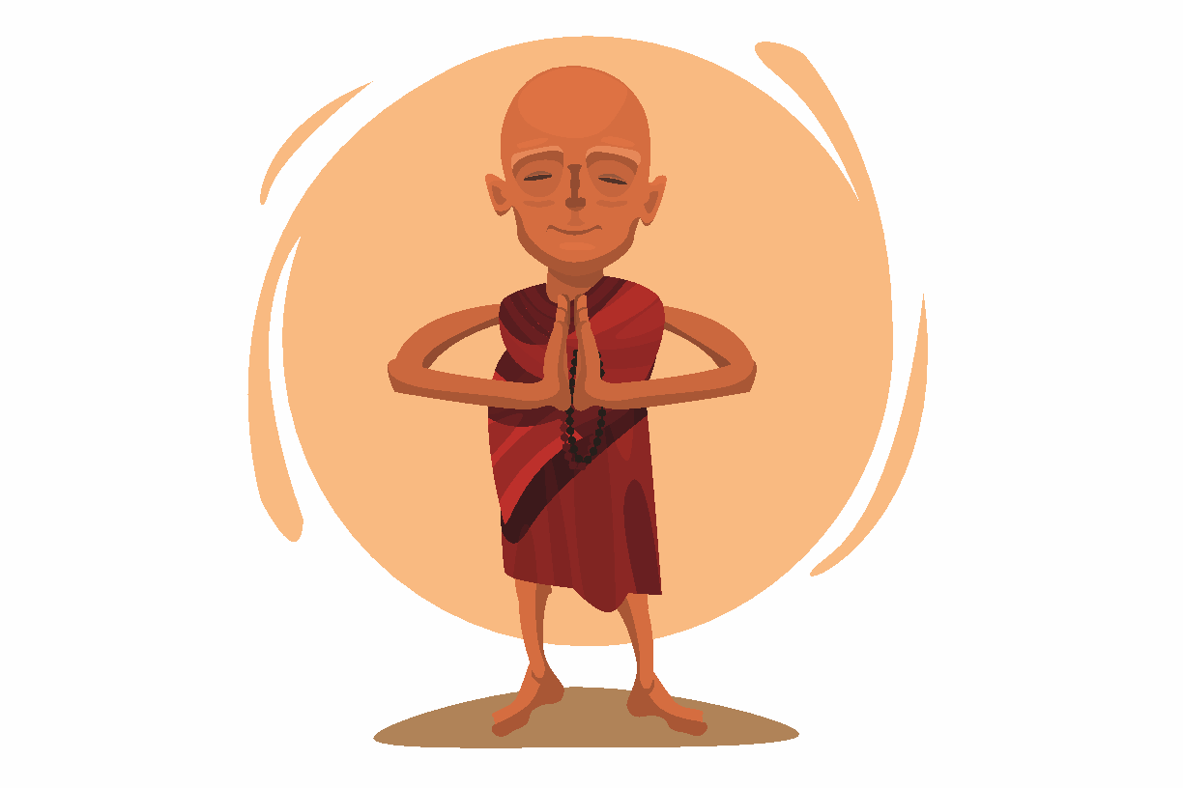
“Happiness is not
something ready made.
It comes from your
own actions.”
Dalai Lama
Notes:
RECOGNISING THE NEED FOR ACTION – information
Explain this session encourages pupils to consider the small joys in their lives and how they can make them happen through action.
Explain that, later in the session, pupils will identify some simple actions and challenges they can do – at school, at home and wider.
Additional information: The Dalai Lama is the head monk of Tibetan Buddhism. Tibetan Buddhists believe that the Dalai Lama is the god of compassion who comes to Earth to help people.

Slide 11
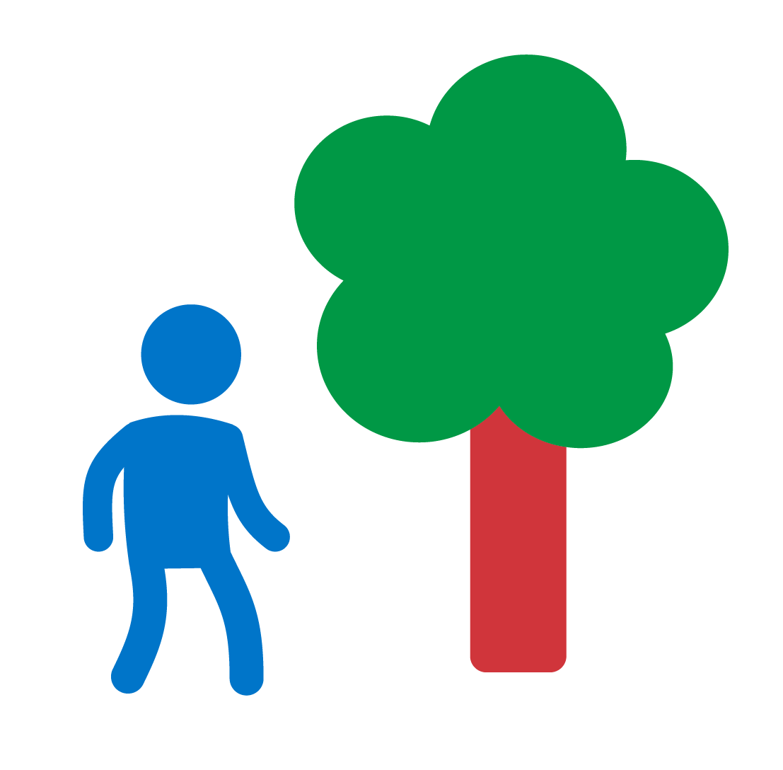
FIVE WAYS TO WELLBEING: OUR HAPPINESS ACTIONS
Connect
to people and nature.
Notice
be aware of moments and details.
Move
be active.
Discover
try new things and keep learning.
Give
be kind and
help others.
Notes:
IDENTIFYING THE FIVE WAYS TO WELLBEING – information
Use the slide to share the five happiness actions: these are things that pupils can do to help make themselves and others happy.
Connect – to people and nature (positive relationships are critical to wellbeing; connecting to nature is proven to improve wellbeing).
Notice – be aware of moments and details (take time to appreciate things; mindfulness; focus on here and now instead of worrying about past/present).
Move – be active, sit less and get outside (being physically active is as good for our mental/emotional health as our physical health)
Discover – try new things and keep learning (curiosity and learning new skills keep our brains active and healthy – and builds confidence).
Give – be kind and help others (this includes small kindnesses – smiling or saying thank you – as well as ‘service’ or volunteering).
Clarify that the actions may be linked; they are not necessarily separate, e.g. by helping people you are also connecting to them.
The following slides provide activities to deepen/test pupils’ understanding and provide examples.
Background information for teacher: Five Ways to Wellbeing is a set of evidence-based public mental health messages aimed at improving the mental health of the UK population. They were developed by a government think-tank in 2008 and are used across the UK by national and local agencies. Mind produces a simple summary for adults: https://www.mind.org.uk/media/4220803/five-ways-to-wellbeing_poster.pdf The Travel to Tokyo resources have tweaked the language of the five ways to wellbeing but the principles are the same.

Slide 12
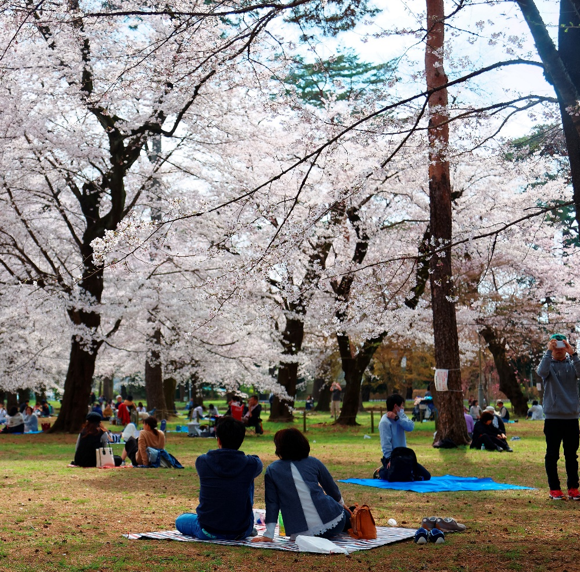
O-HANAMI
O-HANAMI
Which happiness actions are involved?
In spring, Japanese people go to view cherry trees in blossom (Sakura). This is called O-Hanami.
People have picnics and eat Sakura Mochi – sweet rice cakes wrapped in leaves.
Notes:
HAPPINESS ACTIONS IN JAPAN – examples/activity
EITHER share each of the Japanese examples if there’s time OR select the one that suits your pupils/links to an Active Challenge they might do after the session.
After describing each example, ask pupils to suggest which of the happiness actions are involved in that example.
To create an active learning opportunity, call out the actions and ask pupils to jump up/stand/stretch if they think it is involved.
Ask pupils to justify their answers, e.g. how is that action being shown in the example?
O-Hanami answers could include:
Connect – people gather with friends, families and strangers; they connect with the trees and blossom.
Notice – the trees only blossom for a short period – and the petals are easily blown away – so people have to appreciate them at the time.
Move – as many of the trees are in parks, people will walk around to look at them.
Discover – young people learn to make the Sakura Mochi from their elders.
Give – people bring gifts of food – usually homemade – to eat at the picnics.
Challenge: sort pupils into groups and ask each group to discuss one example and feed back to the other pupils.
N.B. The Active Challenge (bring nature indoors) links to this example.
During the period of social distancing, this Active Challenge has been adapted to encourage the children to bring the outdoors in. If you share this example, please explain this is what Japanese people usually do in spring but, during the Coronavirus pandemic, they will watch the cherry blossom through the window or look at photos of last year’s trees.

Slide 13
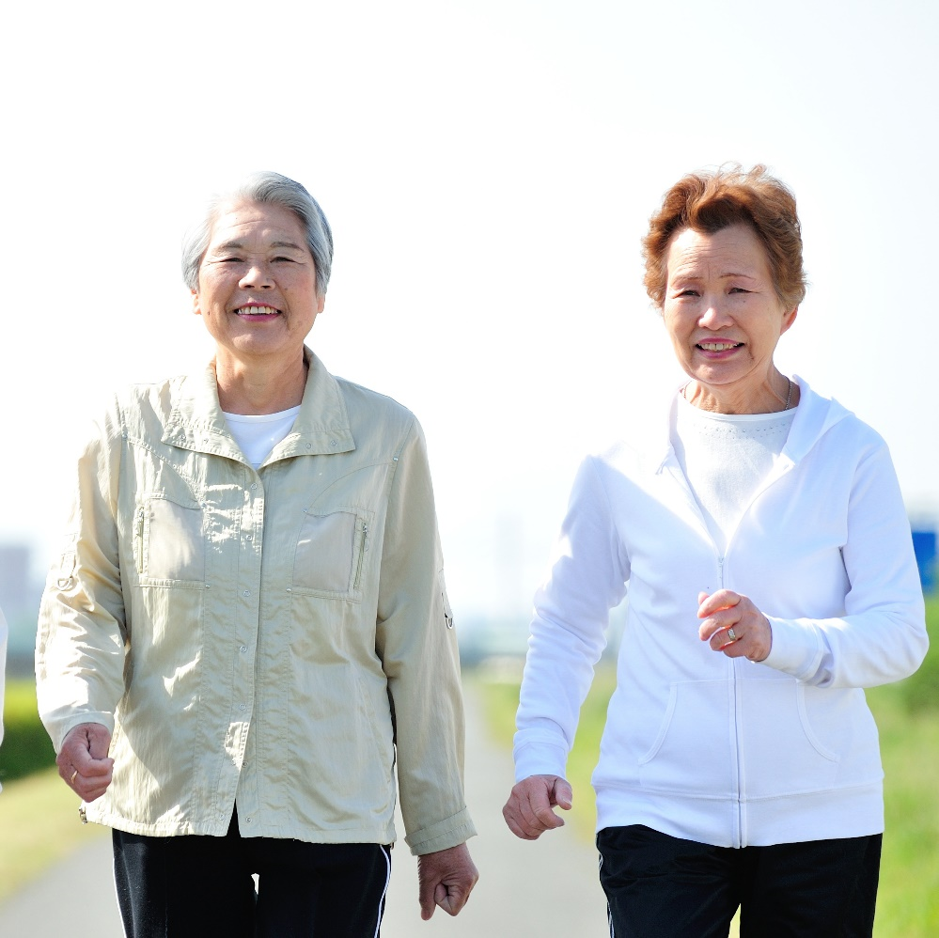
KEIRŌ-NO-HI
Which happiness actions are involved?
Japan has many older people. They are very active and respected.
Keirō-no-Hi (Respect for the Aged Day) is a public holiday. It celebrates older people. For example, schools give performances or older people take part in fitness displays.
Notes:
HAPPINESS ACTIONS IN JAPAN – examples/activity
EITHER share each of the Japanese examples if there’s time OR select the one that suits your pupils/links to an Active Challenge they might do after the session.
After describing each example, ask pupils to suggest which of the happiness actions are involved in that example.
To create an active learning opportunity, call out the actions and ask pupils to jump up/stand/stretch if they think it is involved.
Ask pupils to justify their answers, e.g. how is that action being shown in the example?
Keirō-no-Hi answers could include:
Connect – young and older people are connected with each other through events.
Notice – young people in Japan make time for and appreciate older people for their wisdom.
Move – a high number of older people in Japan are still very active; they take part in the fitness displays and events.
Discover – young and older people learn new skills and activities from each other.
Give – younger people put on activities and performances for older people.
Challenge: sort pupils into groups and ask each group to discuss one example and feed back to the other pupils.
N.B. The Active Challenge (connect with older people) links to this example.
During the period of social distancing, this Active Challenge has been adapted to encourage the children to connect with older people within their family and/or use other media to connect to those outside their home, e.g. phone call, screen calls (Skype, Zoom, FaceTime, etc.), messaging, email or post.

Slide 14
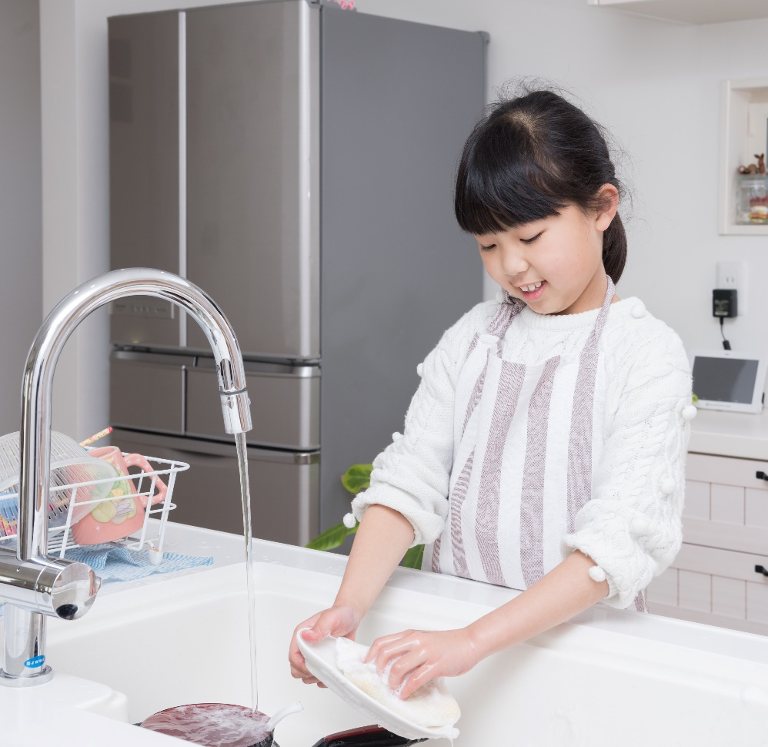
OMOIYARI
Which happiness actions are involved?
Omoiyari is very important in Japan. It means being kind and helping someone before they ask for help. It can be a large or small act of kindness.
For example, in Japan, pupils clean their schools and serve the lunch.
Notes:
HAPPINESS ACTIONS IN JAPAN – examples/activity
EITHER share each of the Japanese examples if there’s time OR select the one that suits your pupils/links to an Active Challenge they might do after the session.
After describing each example, ask pupils to suggest which of the happiness actions are involved in that example.
To create an active learning opportunity, call out the actions and ask pupils to jump up/stand/stretch if they think it is involved.
Ask pupils to justify their answers, e.g. how is that action being shown in the example?
Omoiyari answers could include:
Connect – people connect by being kind to and helping each other.
Notice – to anticipate someone’s needs you need to pay attention to them and to what is happening.
Move – helping others often includes doing physical tasks, such as cleaning.
Discover – to be helpful, you may need to learn new skills or try new activities.
Give – giving is not about money or stuff: being kind and helping others means giving time, energy and ideas.
Challenge: sort pupils into groups and ask each group to discuss one example and feed back to the other pupils.
N.B. The Active Challenge (kindness) links to this example.
During the period of social distancing, this Active Challenge has been adapted to encourage the children to be kind to and help others at home or use other media to support others outside their home. If pupils are at school, they can explore helping other pupils in school, in accordance with your social distancing guidance in school.

Slide 15
WHICH ACTIONS MADE YOU HAPPY?
Connect
to people and nature.
Notice
be aware of moments and details.
Move
be active.
Discover
try new things and keep learning.
Give
be kind and
help others.
Notes:
EXPLORING PUPIL ACTIONS – pair and share activity
In pairs, ask pupils to think about a time when they were happy: which of the happiness actions were involved?
Share some examples in the whole class.
Explain that pupils will think about actions they can do in future, later in the session.
Support: sort pupils into groups and ask each group to consider one happiness action. Ask them to identify personal examples of when they did/experienced that action and how it made them feel.
Challenge: if pupils showed a good understanding of the happiness actions in the previous task, you may wish to omit this stage and jump to future actions.

Slide 16
TO BE ABLE TO DO THE HAPPINESS ACTIONS, WE NEED TO BALANCE…
indoors / outdoors
screen time / real time
working / playing
sitting / standing
awake / asleep
energy in / energy out
Notes:
FINDING BALANCE – information
Explain that to help us to do the happiness actions we need to have a good balance in our daily habits; balance also supports our health and wellbeing.
Balance doesn’t mean doing exactly the same amount of two things every day (e.g. waking/sleeping) but, generally, balancing them across the week.
For pupils who are approaching end of year tests, emphasise the working/playing balance and stress that they still need to find time to relax, be active and get outdoors as well as sit indoors studying/revising. (This message is equally important for school leaders and classroom teachers! Good health and wellbeing are essential for educational achievement.)
N.B. ‘energy in’ and ‘energy out’ is a very simplistic summary of the need to balance eating with activity. We do not want to promote calorie-counting with pupils! They just need to recognise that if you keep eating without exercising you are likely to put on weight and vice-versa. See Change4Life if you want to explore nutrition and healthy eating in more depth with pupils: https://www.nhs.uk/change4life/food-facts
The following slides show how Olympic and Paralympic athletes balance their sporting and wider lives and find time for the happiness actions.

Slide 17
HOW DO ATHLETES FIND BALANCE AND STAY HAPPY?
It’s really important for athletes to be able to focus on their sporting performance when it matters, but also be able to switch off from that sporting lifestyle sometimes.
Notes:
FINDING BALANCE AND MAKING MYSELF HAPPY – athletes’ examples
Use the following slides to share how Olympic and Paralympic athletes balance their sporting and wider lives and find time for the happiness actions.
Use as few or as many as you wish depending on time.
Challenge: in small groups, ask pupils to read the athletes’ examples and discuss how they reflect the five happiness actions.
Alternatively, print the examples and post them on the class/school noticeboard so pupils can read them after the session.

Slide 18
HOW DO ATHLETES FIND BALANCE AND STAY HAPPY?
Bradley Forbes-Cryans is a Scottish slalom canoeist who has been selected to represent Team GB at the Tokyo 2020 Olympic Games. Bradley finds balance by:
staying connected with his friends and family
keeping active outside of his sport, by running and playing golf
learning new languages so he can communicate with foreign athletes and competitors.
“Every evening, I think about a specific point in the day when I did something good or something went particularly well.”
Bradley’s top tip for feeling happy
Notes:
FINDING BALANCE AND MAKING MYSELF HAPPY – athletes’ examples
Use the following slides to share how Olympic and Paralympic athletes balance their sporting and wider lives and find time for the happiness actions.
Use as few or as many as you wish depending on time.
Challenge: in small groups, ask pupils to read the athletes’ examples and discuss how they reflect the five happiness actions.
Alternatively, print the examples and post them on the class/school noticeboard so pupils can read them after the session.

Slide 19
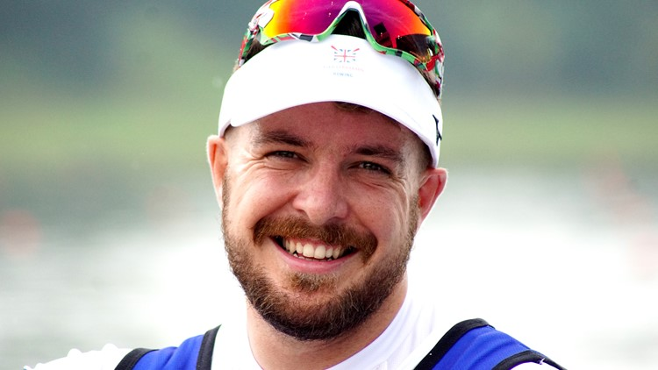
HOW DO ATHLETES FIND BALANCE AND STAY HAPPY?
Benjamin Pritchard is a Welsh para rower who is hoping to represent Great Britain at the Tokyo 2020 Paralympic Games. He only took up rowing in late 2016. Benjamin finds balance by:
taking time to treasure and appreciate the small things in life
sharing and swapping homegrown vegetables with his neighbours.
staying well connected with his family using all forms of social media
Benjamin’s top tip for feeling happy
“Do whatever puts a smile on your face. Do not worry about what other people think of it. If it makes you smile and happy then it is 100% worth it.”
Notes:
FINDING BALANCE AND MAKING MYSELF HAPPY – athletes’ examples
Use the following slides to share how Olympic and Paralympic athletes balance their sporting and wider lives and find time for the happiness actions.
Use as few or as many as you wish depending on time.
Challenge: in small groups, ask pupils to read the athletes’ examples and discuss how they reflect the five happiness actions.
Alternatively, print the examples and post them on the class/school noticeboard so pupils can read them after the session.

Slide 20
WHAT SMALL STEPS WILL I TAKE?
At school
At home
In the community
Help a classmate with some school work.
At breaktime, listen carefully to all the sounds I can hear.
Play a new game with friends in the playground.
Read a library book in a quiet corner.
Organise some activities for younger pupils.
Ask my family what they did during the day.
Wash the dishes after tea.
Play games with my brothers or sisters in the garden or street.
Watch the weather on a stormy day.
Make something out of junk.
Encourage my family to do some Radio Taiso.
Ask permission first!
Make a sign of support to display in the window.
Feel the bark on the trees as I walk in the park.
Walk to areas of my community I have not visited before.
Pick up the litter in my street.
Take part in fundraising for a charity.
Notes:
IDENTIFYING POTENTIAL ACTIONS – pick and mix activity
Explain that small actions that pupils will do are better than big intentions that never happen. Small steps are good!
Share the examples on the slide. Reinforce these are just examples. Pupils need to do happiness actions that fit their interests and fit in with their lives.
Emphasise the need for pupils to seek permission from parents/carers and teachers as appropriate, especially for community actions.
Ask pupils either to pick one of the examples (support) or identify their own idea (challenge).
Ask pupils to mingle and meet with a partner for 30 seconds: they share their ideas with the partner; move, mix and share again. Each time they meet a new person they share a different idea (even if it is just a slight variation).
For a very large group/non-active alternative: pupils just share their ideas with someone on their left/right/behind as they are sitting.
You could have three rounds: one each for school, home and the community.
N.B. Radio Taiso are simple exercises that are broadcast on Japanese TV and radio. See the Tokyo Ten activity guide: https://www.getset.co.uk/resources/travel-to-tokyo/tokyo-ten The Radio Taiso Active Challenge encourages pupils to involve their friends and family at home.
During the period of social distancing, ask pupils to suggest adaptations/alternatives in accordance with the national/your school’s guidance.

Slide 21
MY HAPPINESS PLEDGE
To make myself and others happy I will…
What will you do today?
What will you do this week?
What will you do this month?
Write your pledge on the back of a postcard.
Draw your actions on the front.
Put it on the fridge as a reminder.
Notes:
PLEDGING TO TAKE ACTION – activity
EITHER during or AFTER the session, ask pupils to make themselves a personal postcard on which they record their pledges. These should be practical actions (small steps) they can do – today, during the week, during/over the month.
Write the pledges on the back of the postcard.
Draw the actions on the front.
Ask pupils to address the postcard to themselves and EITHER take it home to stick on the fridge (or similar) OR gather them in at the end of the lesson, then re-issues them after a week or so as a reminder.
Alternatively, pupils could just make a verbal pledge, but experience shows that people are more likely to keep a written pledge. (You could also use the pledges as evidence of pupils’ personal development/wellbeing by revisiting them and evaluating their impact at a later stage.)

Slide 22
Notes:
PERSONAL PLEDGE activity sheet – to copy if required (2 postcards per A4 sheet)

Slide 23
See how the nation is getting active: getset.co.uk/show-tell
Share your activities at:
getset@getset.co.uk #TTTYourWay @GetSetCommunity (Twitter) or @GetSetClub (Instagram)
Contact us: getset@getset.co.uk
Notes:
TEACHER INFORMATION

