Slide 1
Newburgh Primary School

Slide 2
Newburgh Primary School Values
Nurturing
Engaged
Welcoming to everyone
Be considerate
Unique
Resilient
Great achievers
Happy and Healthy

Slide 3
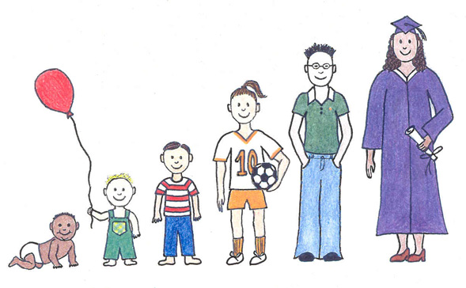
Nurturing
verb
If you nurture something such as a young child or a young plant, you care for it while it is growing and developing.

Slide 4
February thoughts in the garden
To compare gardening with thinking –
both need care and nurture!

Slide 5
Your mind is a garden
Your thoughts are the seeds
The harvest can be either flowers or weeds.

Slide 6
‘flower' or 'weed'

Slide 7
‘flower' or 'weed'

Slide 8
‘flower' or 'weed'

Slide 9
‘flower' or 'weed'

Slide 10
‘flower' or 'weed'

Slide 11
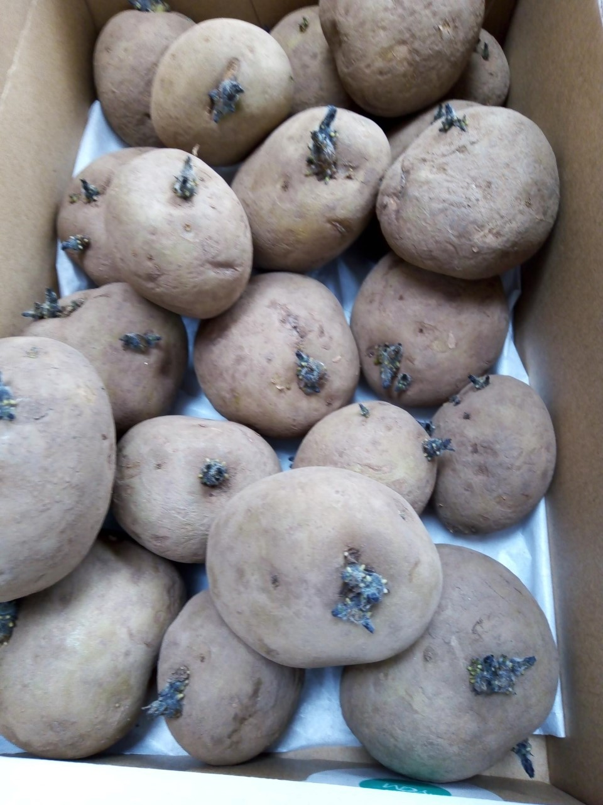
‘flower' or 'weed'

Slide 12
Thoughts- seeds or weeds?
Martin’s story was brilliant.
She'll never know if I take that biscuit.
I don't like it when Karen wants to join in. You look lonely. Can I help?

Slide 13
Thoughts- seeds or weeds?
I'll give Mum a hand this morning.
I don't care if she's upset, it serves her right.
I am going to try to do good writing today.

Slide 14
‘Finally, (children), whatever is true, whatever is noble, whatever is right, whatever is pure, whatever is lovely, whatever is admirable – if anything is excellent or praiseworthy – think about such things.’ (Philippians 4.8)
Monday 14th Jan
Thursday 24th Jan
Monday 28th Jan
w/k 4th February-No Staff Meeting
Thursday 14th February
Wednesday 27th February 3:45 to 5:15pm
Monday 4th March
Thursday 14th March
Monday 18th March
Thursday 28th March
Monday 1st April
w/k 8th April No Staff Meeting

Slide 15
Reflection
be careful what we think
because what we think often leads to what we become.

