Slide 2
Notes:
Extension: can students think of what types of jobs these people might have had?

Slide 3
Notes:
Optional: ask them to discuss the above questions in pairs.
Challenge: ask students if they can think of a memory which makes them both happy and sad. Can they explain why it makes them feel both?

Slide 4
Notes:
Explain that the last place you acted out is real! It is called the Glade.
Explain that the National Memorial Arboretum is a site in Staffordshire, full of almost 400 memorials amongst 25,000 trees. It is a year round space to celebrate lives lived and remember lives lost, helping each generation remember the unique contribution of those who have served and sacrificed.
Explain that for this lesson they will be exploring remembrance by looking how it makes them feel and coming up with their own creative way to remember using the Glade as inspiration.

Slide 5
Notes:
Have them discuss what they think each picture symbolises or means.
Extension: Why do plants have meaning? Can anyone think of other examples?
You can explain to them that a symbol is something that stands for or represents something else.

Slide 6
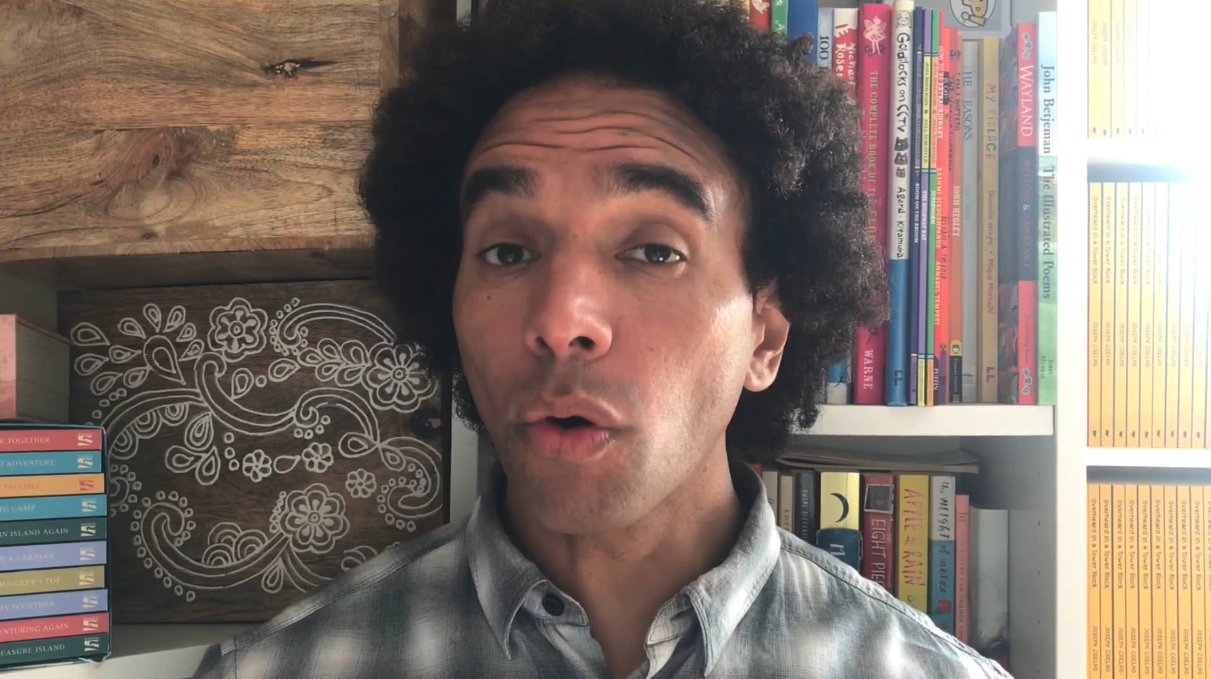
Notes:
Explain that a professional poet Joseph Coelho has been to the Glade and come up with his own way to express his feelings about Remembrance using a poem.
If possible provide pupils with a print out of the poem, then play Joe’s performance of it and have the pupils read along with it.

Slide 7
Notes:
© Joseph Coelho 2020
Make sure to take time going through the poem. Stop to check if they understand what they read and if they have any questions.

Slide 8
