Slide 1


Year 6 Red Ridge Residential
Monday 15th - Friday 19th June 2026
Notes:
Welcome:
Thank you for all coming tonight – its so lovely to have you in school
If you have any questions there is a time at the end and opportunities to chat to the teachers too.
This presentation will also be made available on the school website – so don’t worry about making any notes.

Slide 2
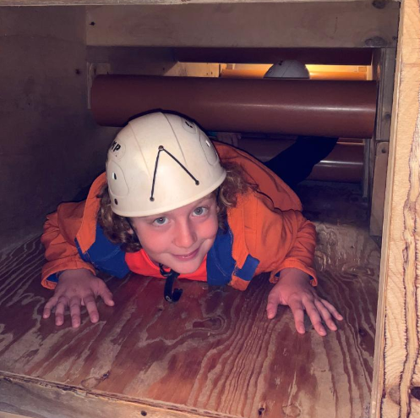
What do we do there?
Archery
Climbing and abseiling
Cycling
Indoor/Outdoor Caving
Canoeing
Hill walking
Kayaking
Zip wire
Orienteering
Activities are either on site or a short coach journey away.

Slide 3
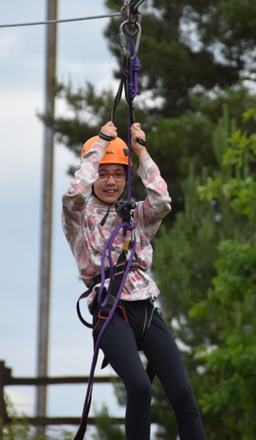
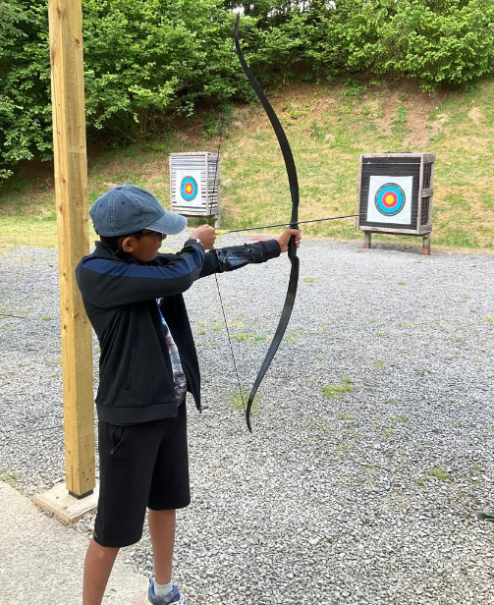
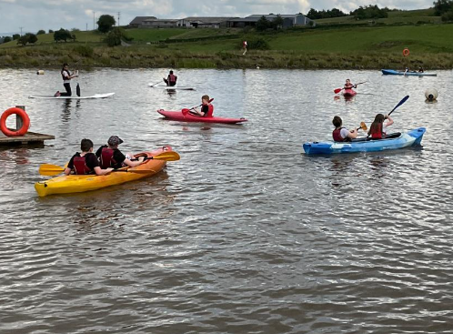
Activities

Slide 4
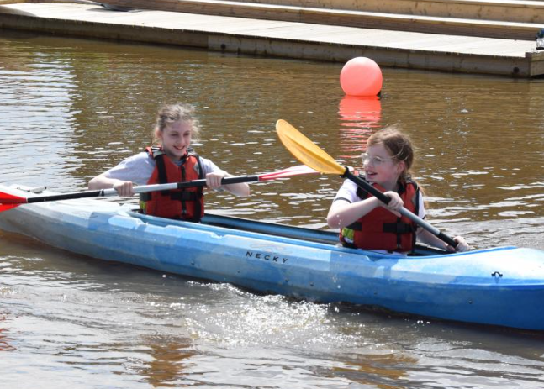

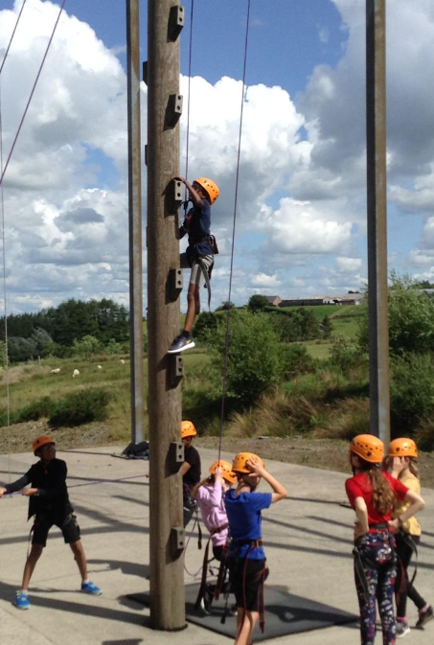
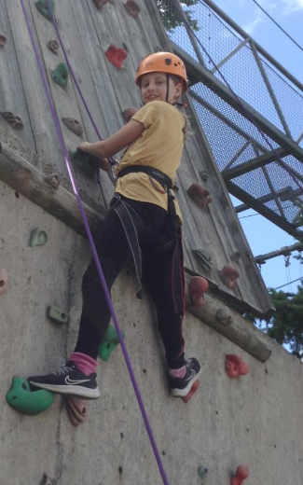
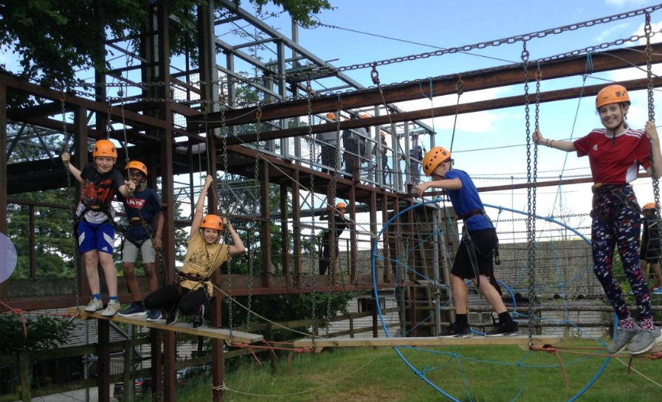

Slide 5
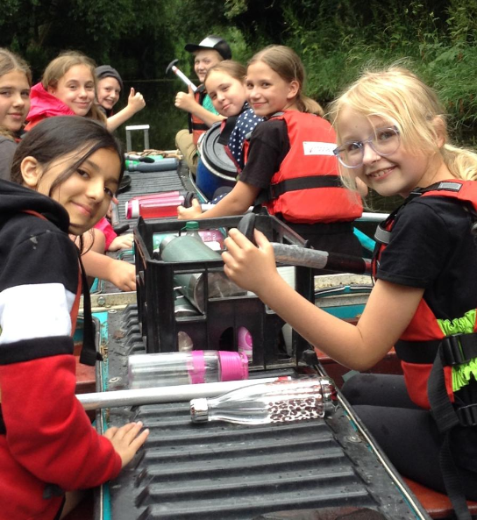
What is it like there?
Red Ridge is a purpose built facility.
The bedrooms sleep 4 – 6 people, all located on the same floor.
Showers and toilets are located beside or along the corridor from the bedrooms.
Highly trained instructors.

Slide 6
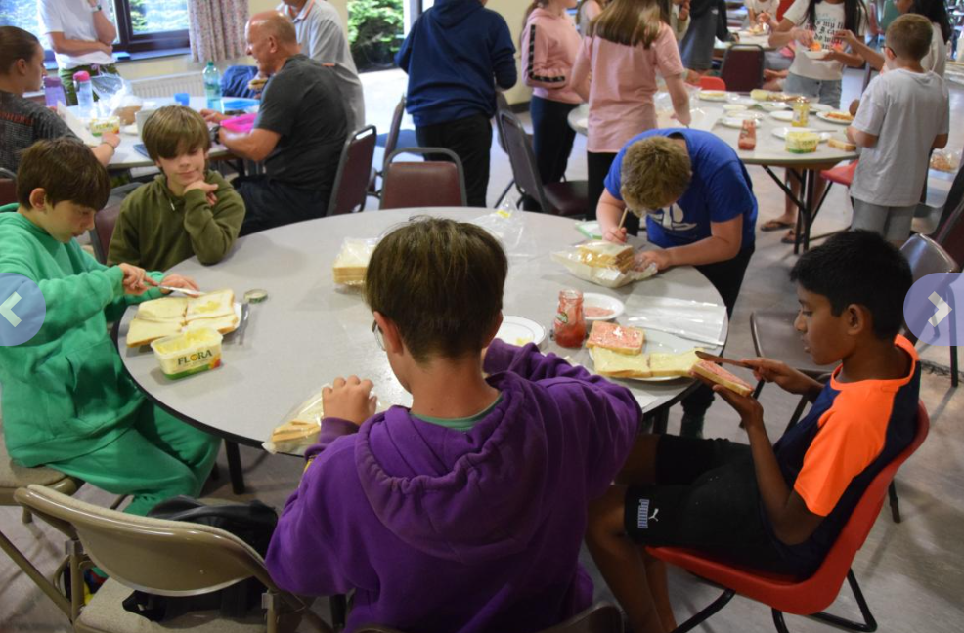
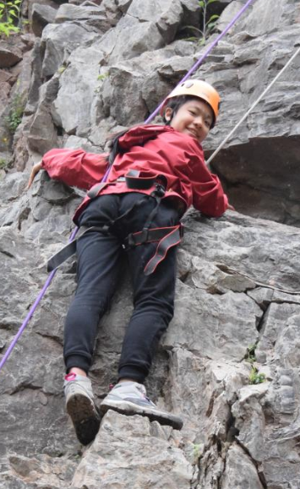
Meals
Fully cooked breakfast and cereal
Children prepare their own packed lunch
Evening cooked dinner
Hot and cold drinks always available
Evening activities planned for the children – Night walk, movie, disco
Gift Shop

Slide 7

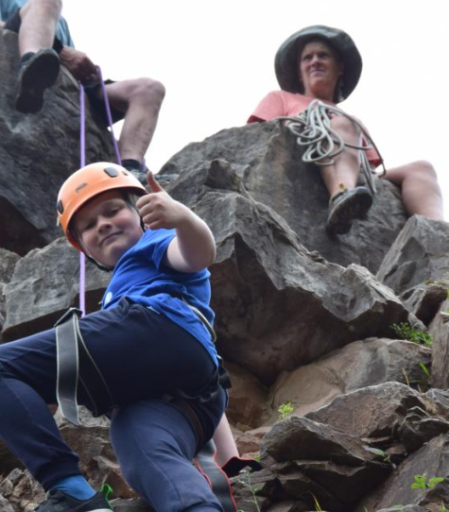
Why Go?
Builds teamwork skills
Raises self-esteem
Develops independence
Opportunity to try new things
It’s lots of fun!
All medical/dietary needs can be catered for
Help with cost may be available

Slide 8
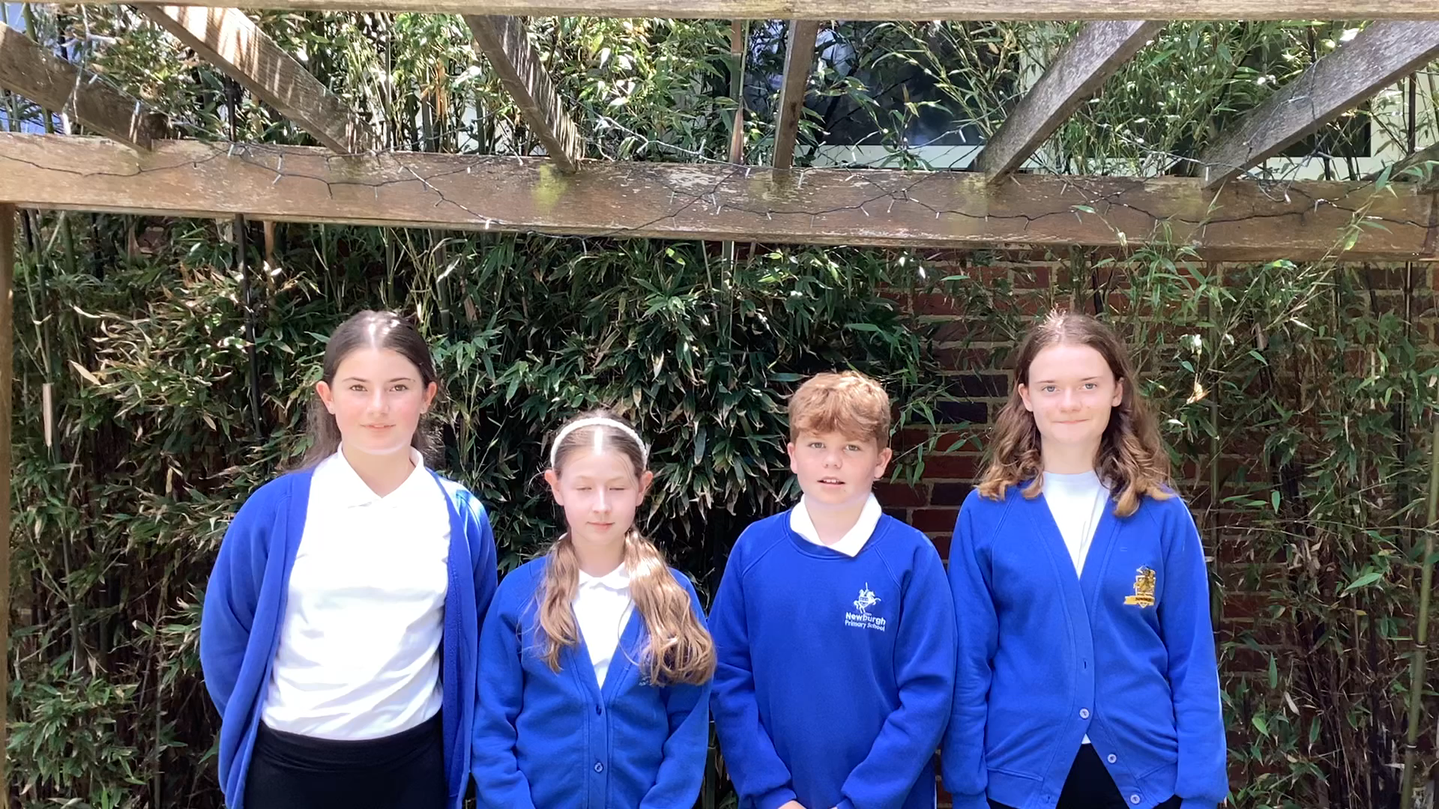

Slide 9
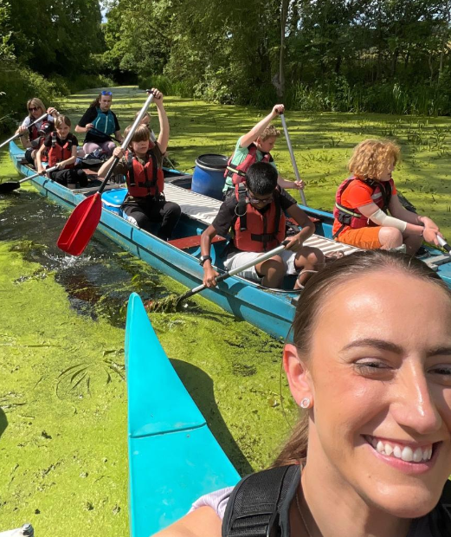
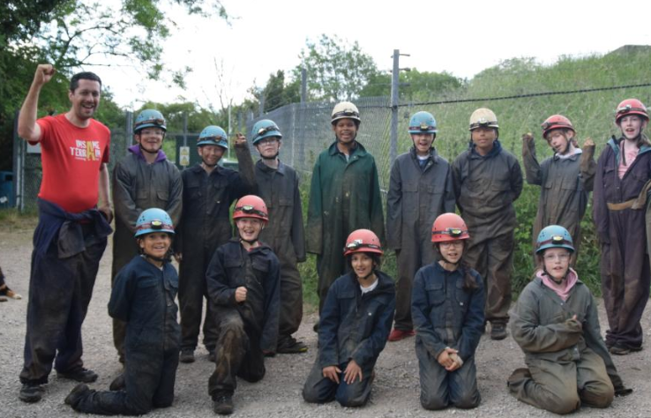
Who will be going?
Adults from school.
Any children in Year 6.

Slide 10
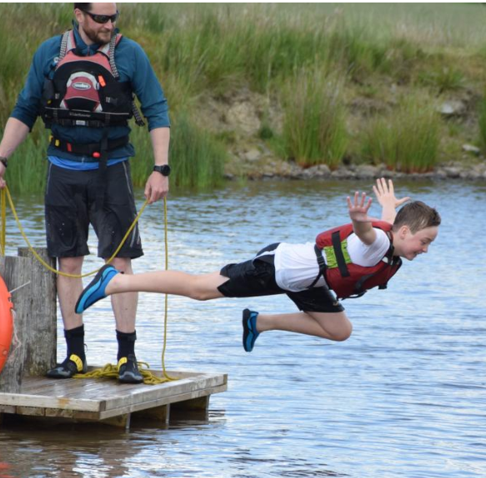
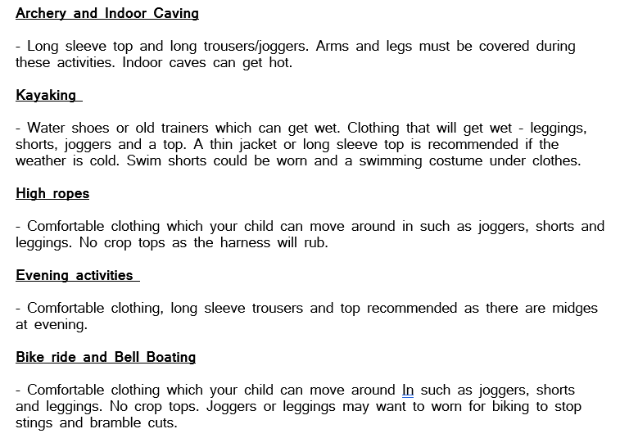

What do you need to provide?
Kit List

Slide 11
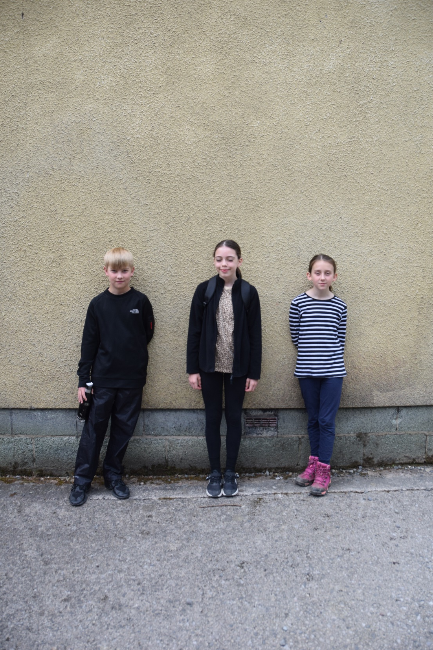

Slide 12
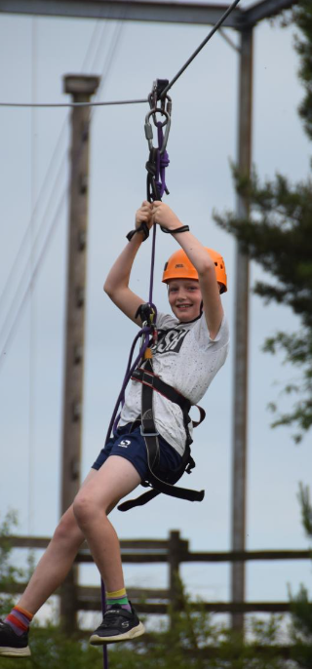
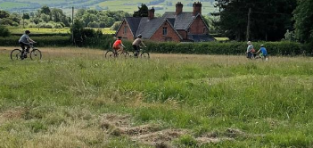
What’s included?
The cost of £360 includes:
All food and drink
Accommodation
Activities run by qualified staff
Safety equipment
Coach Travel

Slide 13
Payment
Deposit (Non refundable) | Monday 3rd November 2025 | £120
Instalment 2 | Monday 2nd February 2026 | £120
Instalment 3 | Monday 13th April 2026 | £120
The cost for the visit will be no more than £360 (exact cost to be confirmed once initial deposits received).
This cost includes transportation by coach, including the two days of off-site activities which are undertaken. This cost also covers all tuition, accommodation, equipment, food and insurance. The only extra that you will be asked to provide will be optional pocket money of £10.00, to be brought in on the day of departure.
Insurance - you may wish to take out insurance in case of cancellation or withdrawal.
Letter will be sent out to you with details tomorrow and a form to show interest. When deposit is paid your place will be confirmed.
Help with payment if necessary can be sought from the Head Teacher or the school office. There is a criteria to be met but we can signpost other support as well.

Slide 14
How can you help prepare your child?
Children will be expected to…
Shower themselves
Be able to fully dress themselves e.g. tie own shoelaces, comb/tie up own hair
Make their own packed lunch including making sandwiches
Be responsible for filling own water bottle
Be responsible for their own belongings e.g. keeping their area of the dormitory tidy
Be able to settle themselves to sleep at night time

Slide 15
Questions?
Remember Red Ridge is experienced in hosting residential trips for children, so all needs can be catered for.
Please speak to your child’s class teacher, Miss Solway or the School Office with any questions you may have at any time.

