Slide 1





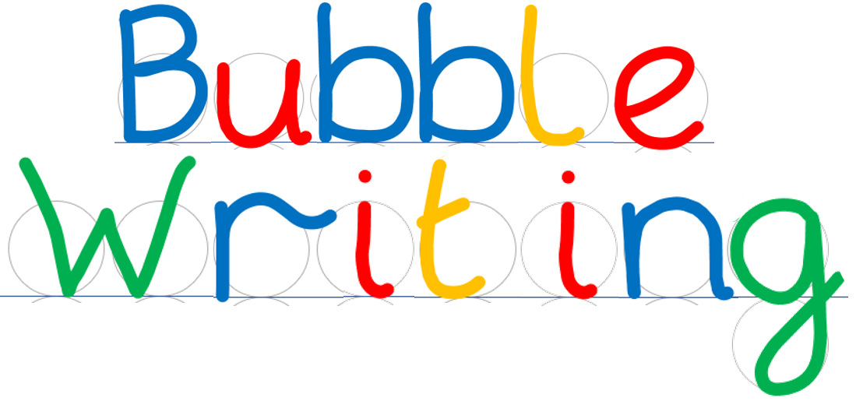
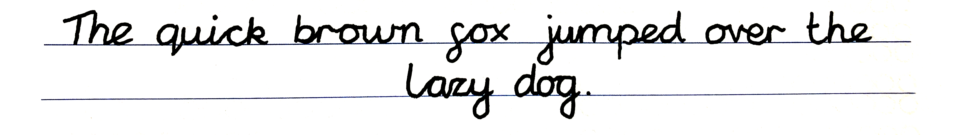
- Handwriting scaffold
©Steve Phillips 2022

Slide 2
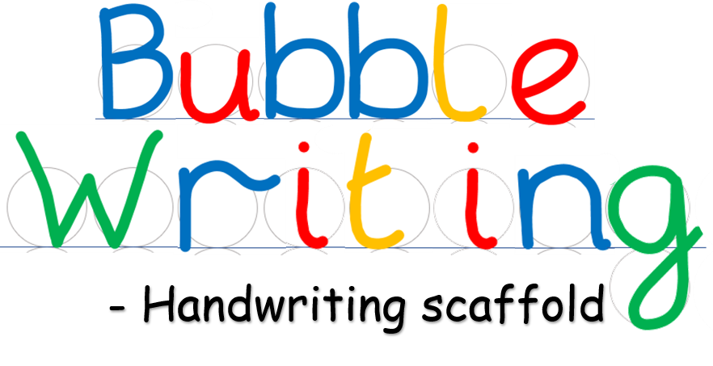



©Steve Phillips 2022

Slide 3



©Steve Phillips 2022

Slide 4


©Steve Phillips 2022

Slide 5

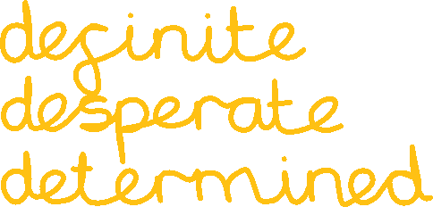
©Steve Phillips 2022

Slide 6





©Steve Phillips 2022

Slide 7
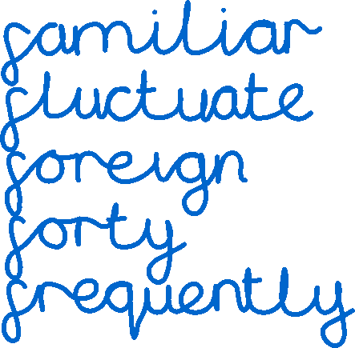
©Steve Phillips 2022

Slide 8
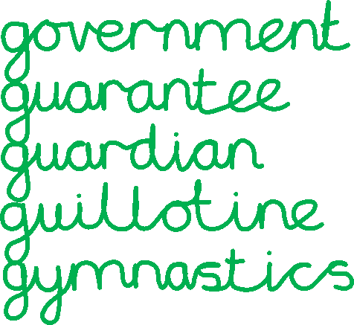
©Steve Phillips 2022

Slide 9





©Steve Phillips 2022

Slide 10




©Steve Phillips 2022

Slide 11

©Steve Phillips 2022

Slide 12

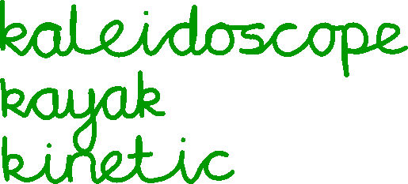

©Steve Phillips 2022

Slide 13


©Steve Phillips 2022

Slide 14




©Steve Phillips 2022

Slide 15

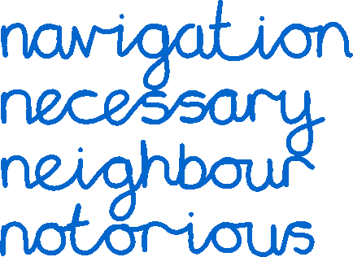
©Steve Phillips 2022

Slide 16



©Steve Phillips 2022

Slide 17
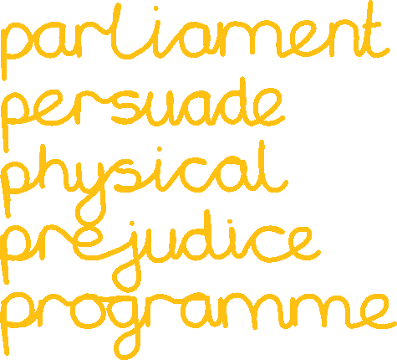
©Steve Phillips 2022

Slide 18
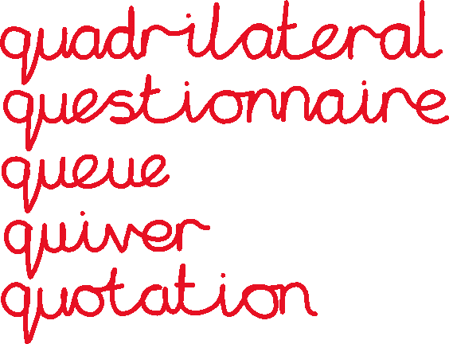
©Steve Phillips 2022

Slide 19




©Steve Phillips 2022

Slide 20


©Steve Phillips 2022

Slide 21



©Steve Phillips 2022

Slide 22





©Steve Phillips 2022

Slide 23
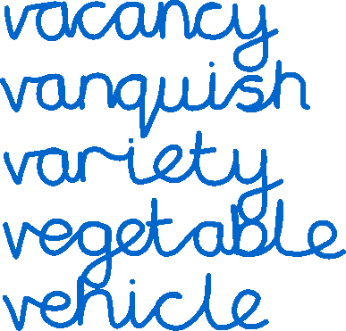
©Steve Phillips 2022

Slide 24



©Steve Phillips 2022

Slide 25


©Steve Phillips 2022

Slide 26



©Steve Phillips 2022

Slide 27
©Steve Phillips 2022

