Slide 1

Newburgh Primary School

Slide 2
Newburgh Primary School Values
Nurturing
Engaged
Welcoming to everyone
Be considerate
Unique
Resilient
Great achievers
Happy and Healthy

Slide 4
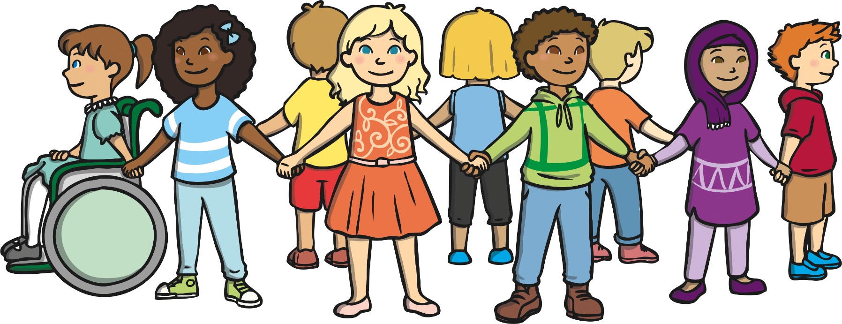
What Is Equality?
Equality is:
understanding that everyone is different but that we are all people
knowing that everyone has the right to be treated fairly
treating others with respect

Slide 5

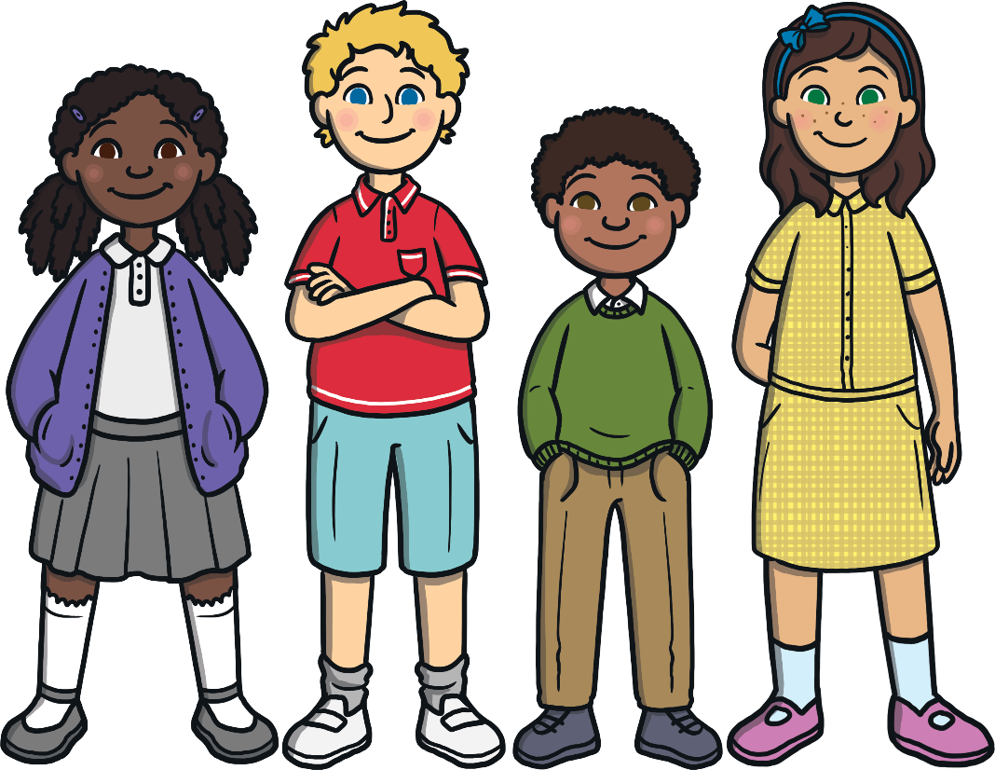
“When I see you through my eyes,
I think that we are different.”
“When I see you through my heart,
I know we are the same.”
Doe Zantama is an author and illustrator.
What do you think she is telling us
with this quote?
Look around the room at your friends.
What is different?
What is the same?

Slide 6
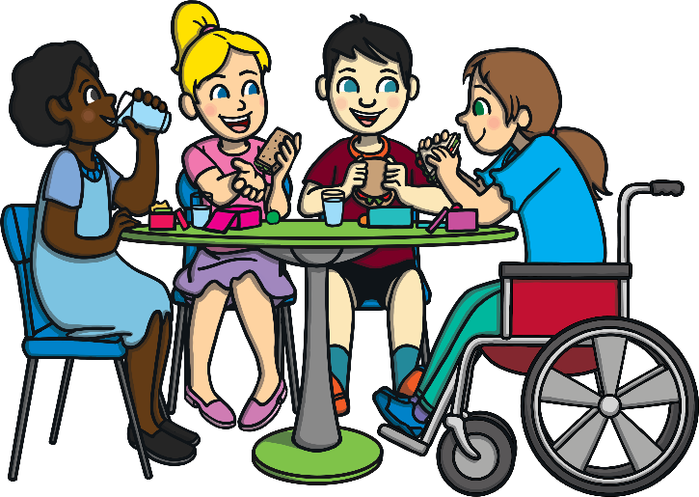
What Things Make Us Different?
eye color
skin color
hair color
our personalities
where we live
what we like
Can you think of anything else that makes us different?

Slide 7
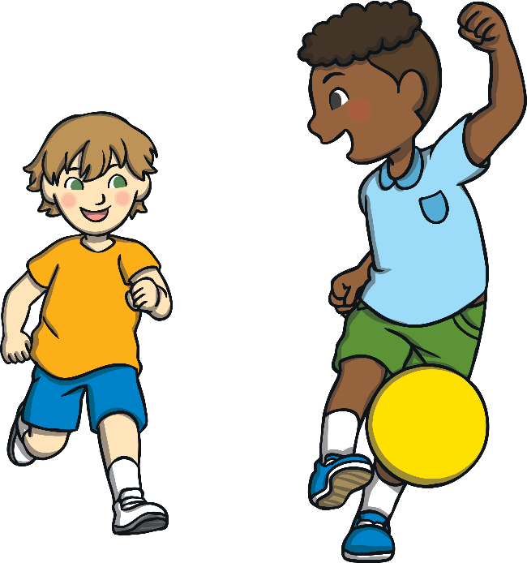
We Are All the Same
We all have thoughts.
We all have likes.
We are all people.
We all have needs.
We all have feelings.
Can you think of anything else that makes us the same?

Slide 8

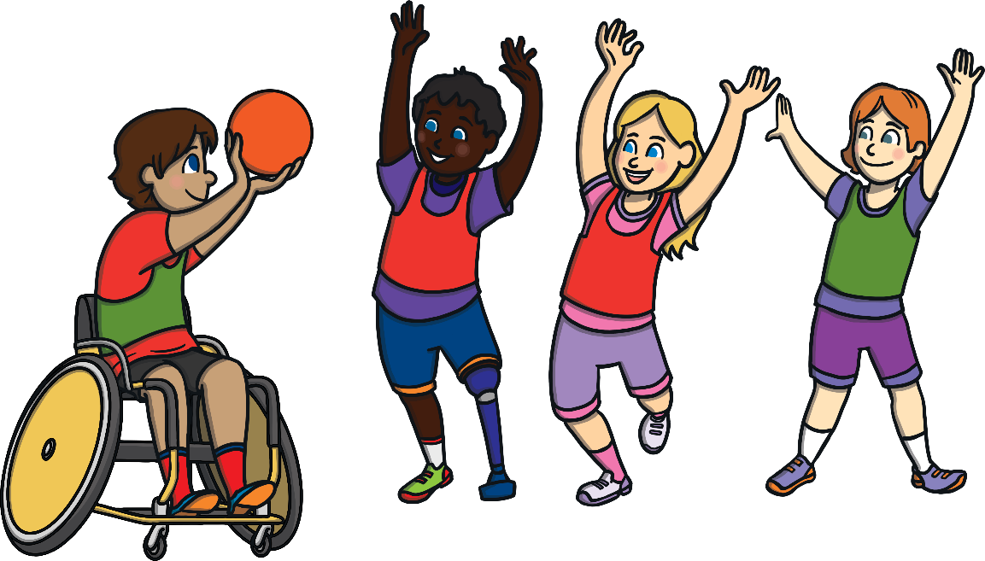
“A person is a person,
no matter how small.”
Dr. Seuss
Dr. Seuss is an author and illustrator.
What do you think he is telling us with this quote?
What does this mean for us at school?

Slide 9

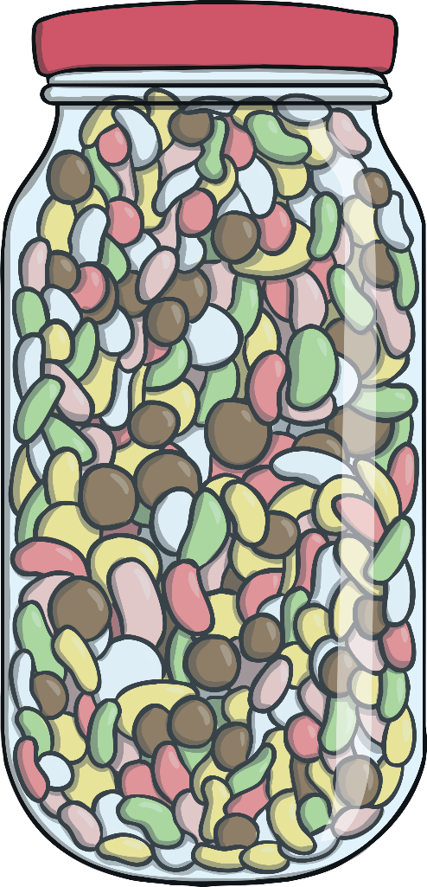
What If…?
What if your teacher shared some candy with the class and gave
two to each boy but said that the girls could only have one?
Is this right?
Is this fair?
What could the teacher do
to treat the students more fairly?

Slide 10

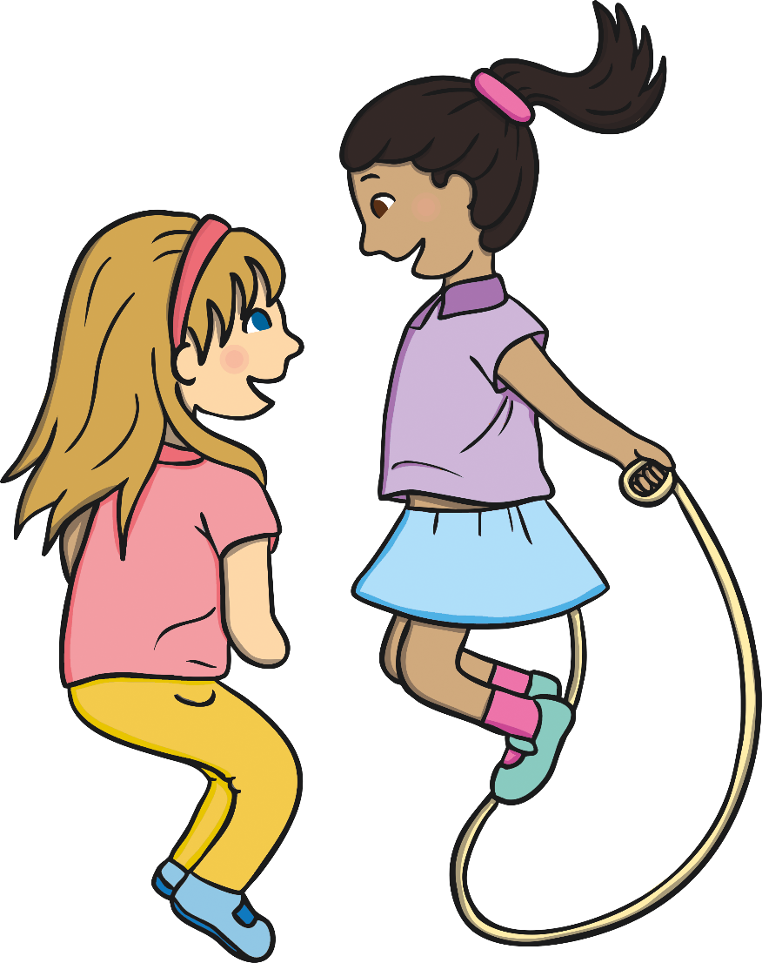
What If…?
What if your classmates are jumping rope in P.E. and your teacher says
that only children with brown hair can have a turn?
Is this right?
Is this fair?
What could the teacher do
to treat the students more fairly?

Slide 11


What If…?
What if you fall and hurt your knee and the teacher gives everyone
in the class a bandage for their knee to make it fair?
Is this right?
Is this fair?
Does equality always mean that
everyone has be treated the same?

Slide 12
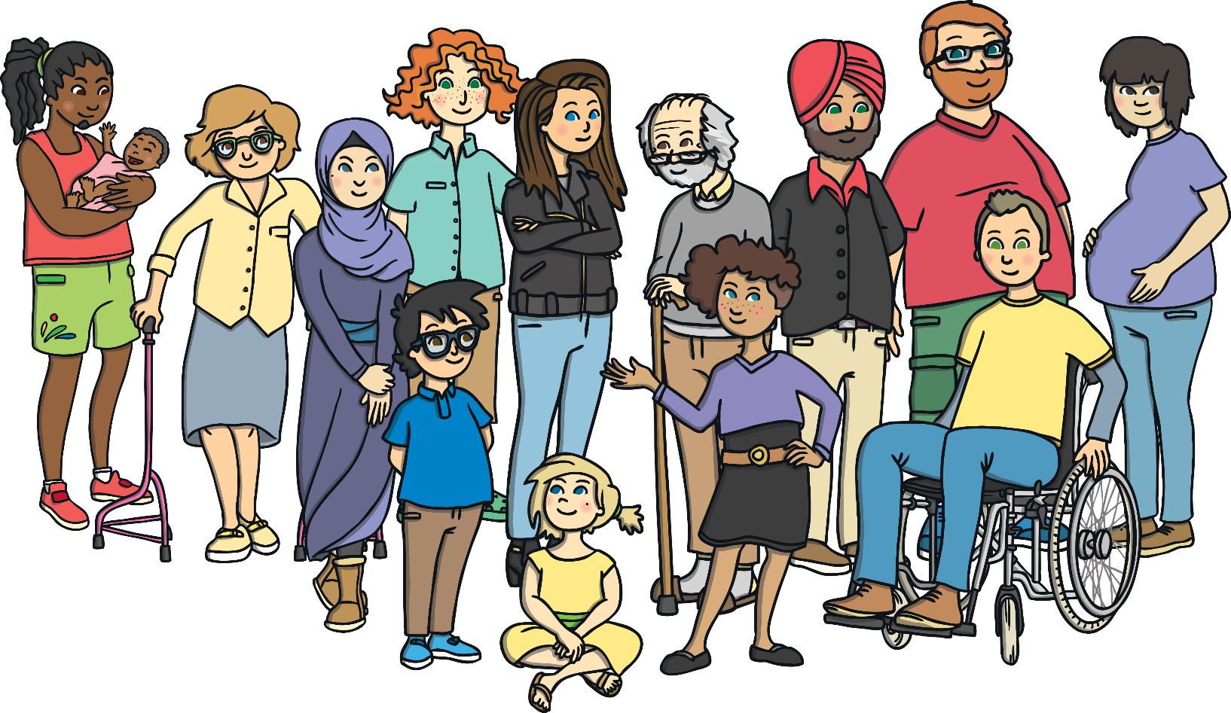
Remember, equality is when we make sure that everyone is treated fairly. It does not mean that everyone has to be treated the same.
What does equality look like in your school and at home?
How do grown-ups make sure that you are treated fairly?

Slide 13
