Slide 1

Newburgh Primary School

Slide 2
Newburgh Primary School Values
Nurturing
Engaged
Welcoming to everyone
Be considerate
Unique
Resilient
Great achievers
Happy and Healthy

Slide 3
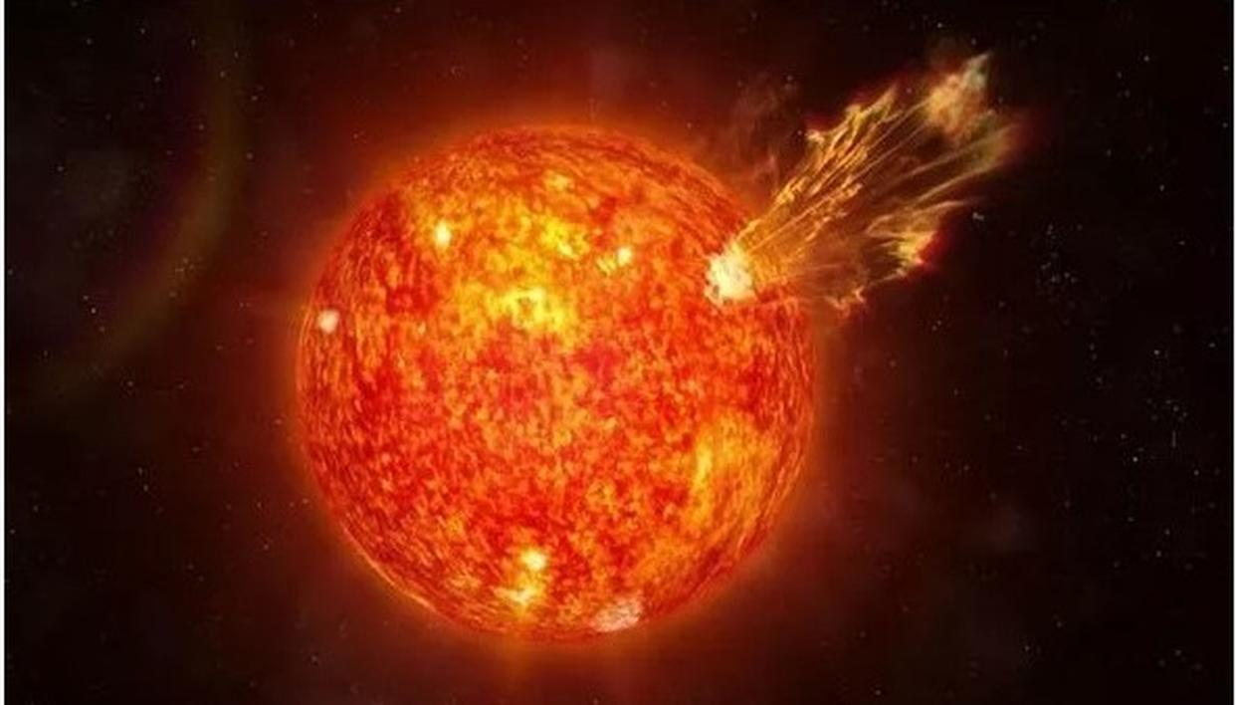

Slide 4
The Sun is actually a star.

Slide 5
The Sun is the nearest star to the Earth – that is why it looks so big!

Slide 6
The Sun is a ball of burning gas.

Slide 7
It takes about eight minutes for light to travel from the Sun to the Earth..

Slide 8
The Sun is the largest object in our solar system.

Slide 9
The Sun is so big that the Earth could fit inside it more than a million times!.

Slide 10
You should never look at the Sun directly.

Slide 11
You should wear sunscreen to protect you from the Sun..

Slide 12
Without the Sun, the Earth would have no heat or light so nothing could live on it.

Slide 13
We can all make a difference to the people we meet every day.
Through our generosity and kindness, we can make a difference to the lives of people.
Let us be people who always think about others and to bring light and warmth into people’s lives

Slide 14
