Slide 2
Notes:
In this assembly, we are thinking about Service and Sacrifice in the Second World War and today as part of our Remembrance commemorations. To commemorate means to remember and celebrate.
Remembrance Sunday is on 8th November. This year we celebrate 75 years since the end of war in Europe in 1945 and we will remember:
The British and Commonwealth forces who fought in the war and the freedom their service and sacrifice gave us
All the people who did not come home
All the people who rebuilt the country after the war
The people who help us today

Slide 3
Remembrance 2020
Remembrance Sunday is on 8th November. This year we celebrate 75 years since the end of war in Europe in 1945 and we will remember:
The British and Commonwealth forces who fought in the war and the freedom their service and sacrifice gave us
All the people who did not come home
All the people who rebuilt the country after the war
The people who help us today
Notes:
Remembrance Sunday is a day to remember the sacrifices of members of the armed forces and of civilians in times of war. It takes place every year and reminds us of the importance of peace and making sure we work together to keep it.
There are church services, special marches and all the armed forces gather to remember. Wreaths are laid at statues and war memorials to remember all the soldiers who died protecting our freedom.
In the Second World War 400,000 British and Commonwealth forces died.
This year we celebrate 75 years of war in Europe – this was called VE Day and you might remember in May there were lots of celebrations about this.
And we also celebrate all the people who did come home and all those who worked so hard to rebuild our country afterwards.
In this assembly we will be thinking about the idea of service and sacrifice, what this meant during the Second World War and what this means for us today.

Slide 4
Notes:
Does anyone know what the word service means?
Service means when people work to help others
Does anyone know what the word sacrifice means?
Sacrifice means when you give up something that is valuable to you for the sake of others
Questions to think about: How do you think people served in the Second World War? What do you think people sacrificed in the Second World War? How do people serve others today? What sacrifices do they make?
The next slides will explore this in more detail.

Slide 5
Notes:
Can you think of those who helped others during in the Second World War? What kinds of jobs did they do?
Examples might include: soldiers fighting on the frontline, pilots fighting in the skies, nurses and doctors, air raid precaution wardens, families looking after evacuees, spies decoding messages, people growing food to help with shortages
Some people helped at home in their local communities, some people helped in the armed forces in other countries. They were all contributing to the war effort.
Norah Grajnert was a helper and served in the Women’s Volunteer Service and then the FANYs. She met her husband whilst she was serving, who was a Polish Officer helping the fightback against the Germans.
Listen to her story. What kinds of things was she doing to help? Why was the work she was doing dangerous?
Norah drove a mobile canteen around the bombed and devastated centre of Bristol for the Women's Volunteer Service, providing food and drink to rescuers and those who were being rescued. She once nearly got crushed by a falling wall after a bombing raid.
Further discussion if time or for later review: what other examples do children know about of people who served in the Second World War? They might be aware of Captain Tom, who recently raised millions for the NHS. Or they may know family members who have wartime experiences, which they might want to share.

Slide 6
Notes:
Today we have people who help us all the time. Can you think of any?
Examples might be parents, carers, siblings, teachers
Look at the pictures. There has also been lots of people helping this year during the coronavirus pandemic. Can you think of who they might be? What kinds of work have they been doing?
Examples might be teachers looking after key workers in lockdown, nurses, doctors, armed forces, community volunteers helping at foodbanks. Children may have experienced direct help themselves, or be aware of this from news reports.
What dangers might they have been facing during this time?
Children will be aware of the possibility of catching the virus. Those serving are generally more at risk and exposed, even with PPE equipment. They may have direct experiences of these dangers via family or friends.

Slide 7
Notes:
Think about the different helpers and the work they did.
Think about the dangers that faced to defend our freedoms and fight the enemy on behalf of their communities and their country.
Think about all the lives they saved by doing this.
Can you think what sacrifices they made?
Examples might be:
Giving time to go and work in the local community, putting themselves in harms way (for example, Air Raid Wardens)
leaving loved ones behind to go and fight and defend freedom for everyone (volunteers, Armed Forces, Medical staff)
fighting on the frontline with the risk of being killed (Armed Forces)
Some sacrifices were ‘bigger’ than others, but they all counted towards defeating the enemy and winning the war.

Slide 8
Notes:
This will help illustrate wartime sacrifice and bring to life a ‘real’ wartime hero

Slide 9
Notes:
Think about:
the different helpers and the work they have done during the pandemic
the danger they faced to help us and fight the virus on behalf of their communities and their country
all the lives they saved by doing this
Can you think of the sacrifices made by the people who have helped during the pandemic?
Examples
Giving time to go and work in the local community, putting themselves in harms way (for example, Food bank volunteers, NHS volunteers)
leaving loved ones to protect them (for example - all of us have had to stay away from family and loved ones to protect them from catching the virus. NHS workers have had to stay in hotels or special accommodation so they don’t give the virus to their families at home whilst they are working)
fighting on the frontline with the risk of being killed (for example NHS staff working to look after people suffering with Covid 19, medical researchers trying to find a vaccine)
Some children may have a more direct experience of these sacrifices – allow them time to share if they wish.
Service and sacrifice helps make our communities safe, saves lives and protects our freedom in times of crisis – like during the Second World War and more recently, during the coronavirus pandemic.
Remembrance is about saying thank you and not forgetting those who gave in service and sacrifice.
But how do we say thank you for and remember service and sacrifice?

Slide 10
Notes:
Put your hands up if you have ever worn a poppy (you may be wearing one now!). Put your hands up if you have ever drawn a rainbow to hang in your window to thank key workers for helping us.
We often use symbols to represent our thoughts about something.
During Remembrance we wear poppies. The poppy was chosen because at the end of the First World War poppies began to grow in the fields where the fighting happened. People wear a poppy to show their respect to those that gave their lives and as a symbol of hope for a peaceful future.
During the pandemic, people put pictures of rainbows in their windows to show support and thanks to key workers and as a symbol of hope that things will get better.
These symbols remind us to take time to remember and thank all the people who gave in service and sacrifice
Further discussion if time or for later review: do children know of any other symbols that represent something important? Perhaps they could create one themselves that represents how they feel about an important issue or loved one?

Slide 11
Notes:
Put your hands up if you have ever participated in a minute’s silence.
Put your hands up if you have joined in with a Clap for our carers.
We use actions to demonstrate our thanks and remembrance too. We hold a two minute’s silence on Remembrance Sunday to remember all those who died so our thoughts can focus fully on thinking about them and the sacrifice they made of giving their lives to fight and defend our freedoms.
The ‘Clap for Carers’ was started at the beginning of lockdown with members of the public applauding from their doorsteps and windows every Thursday at 8pm to thank NHS staff, supermarket workers, teachers and other frontline helpers who were so important in the fight against Covid-19.
These actions helps us take time to remember the service and sacrifice of others.

Slide 12
Notes:
Remind children that it is with the service and sacrifice of others that we won the Second World War.
Remind children that it is with the service and sacrifice of others that we will overcome the Coronavirus.
The experiences of people in the Second World War and our experiences today reminds us of the importance of being brave and helping others.
It is important to think about this so we can understand why we remember.

Slide 13
Notes:
All those who served and sacrificed deserve to be remembered and thanked for what they have done, then and now. We must not ever forget that without their service and sacrifice, our world would be very different and we may not have many of the freedoms and the safety we enjoy today.
Can you imagine what might have happened if people had not given in service and sacrifice?
Examples might be:
Then –people might have starved as they didn’t have enough food, more people would have died, there might not have been enough soldiers to fight, we might not have won the war
Now – people who were shielding might not have had enough food, the hospitals might have become too full, more people might have caught the virus, more people would have died
Can you think about what Remembrance means to you?
Everyone will have their own view and experience of what Remembrance means. Children may have family members who serve in the Armed forces today, or perhaps work on the frontline of the pandemic, such as NHS staff. How do they feel about remembrance now?
Who are you grateful to and who would you like to thank this Remembrance Day?

Slide 14
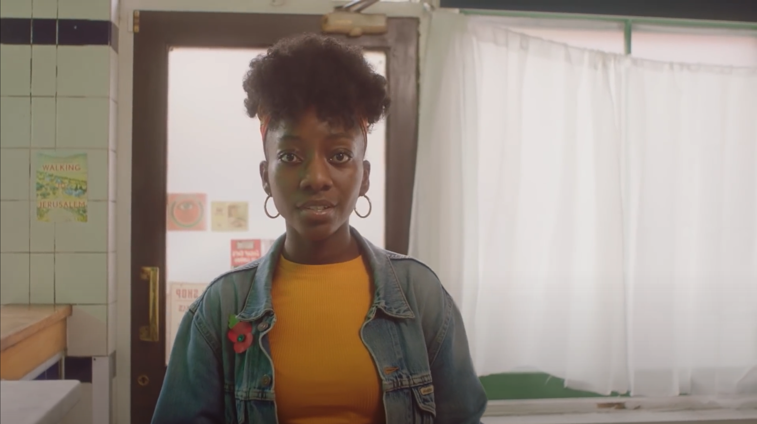
Notes:
Before the minutes silence you could invite a pupil(s) to read:
We remember and thank the British and Commonwealth forces who fought in the war and the freedom their service and sacrifice gave us
We remember and thank all the people who did not come home
We remember and thank all the people who rebuilt the country after the war
We remember and thank all the people who help us today
We are grateful to everyone whose service and sacrifice help ensure a safe and peaceful world today.

