Slide 1
Honouring our heroes from the coronavirus pandemic

Slide 2
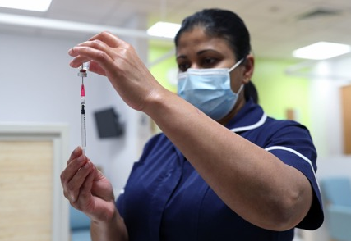
We are taking part in Royal Mail’s
Heroes Stamp Design Competition
Our school is taking part in Royal Mail’s Heroes Stamp Design Competition, to honour our heroes during the coronavirus pandemic.
All children aged 4-14 years from across the UK can enter the competition and a new series of eight stamps will be created.
Here’s more information on the competition and how you can take part...

Slide 3
Royal Mail
For more than 50 years Royal Mail’s Special Stamp programme has commemorated British history and achievement.
Stamps have also been issued to honour the achievements of many British people. Often, the people who appear on stamps are already famous.
They include scientists and explorers, writers, artists, musicians, athletes, and Prime Ministers.

Slide 4
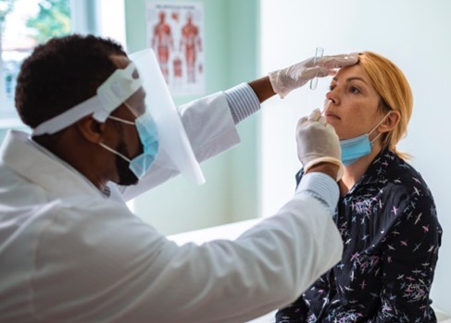
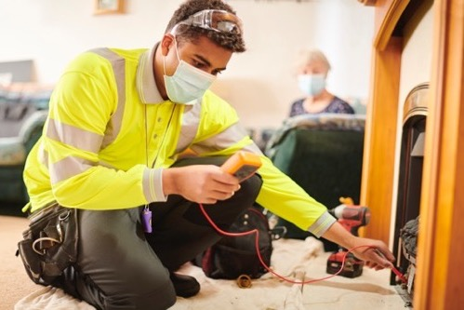
Royal Mail
Since the coronavirus pandemic began, there have been many people who have done great things.
Many of them are not famous, but they have done extraordinary work. These are the people who have helped us all through a really difficult time.
Some are frontline workers in healthcare, others look after elderly or vulnerable people.

Slide 5
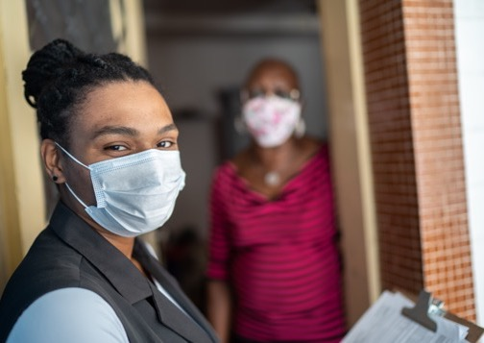
Our Heroes
Millions of key workers have kept the country going when most of us were told to stay home for our own safety. And there have been many people who volunteered to help people in their communities who needed help or support.
We think that what these people have done makes them heroes, so Royal Mail wants to honour them by producing a set of eight stamps.

Slide 6
Our Heroes
Have a think about your heroes over the past year.
Which hero or heroes will you honour on your stamp?
The design is completely your choice, but here are some ideas to get you started:-
Captain Sir Tom Moore
NHS staff
Teachers

Slide 7
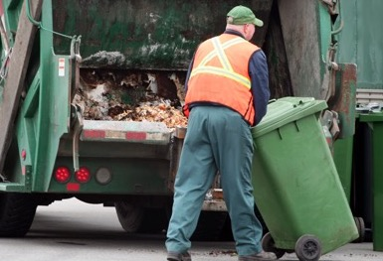
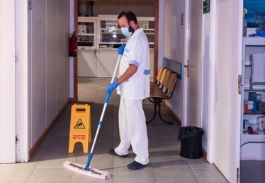
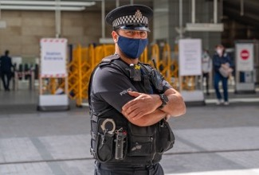
Our Heroes
What about the following groups of people working on the front line, such as refuse collectors, cleaning staff and the emergency services?
Refuse collectors
Cleaning staff
Emergency services

Slide 8
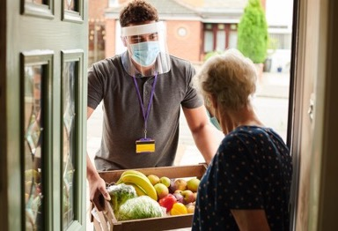
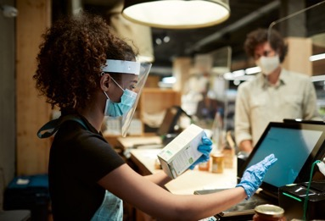
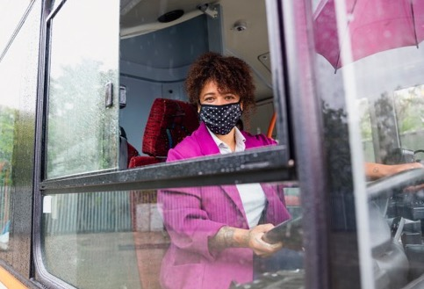
Our Heroes
Many other groups of people such as delivery drivers, supermarket workers, public transport workers, vaccine scientists, military personnel and food bank volunteers have also worked non-stop to keep the country moving.
Delivery drivers
Supermarket workers
Public transport workers

Slide 9
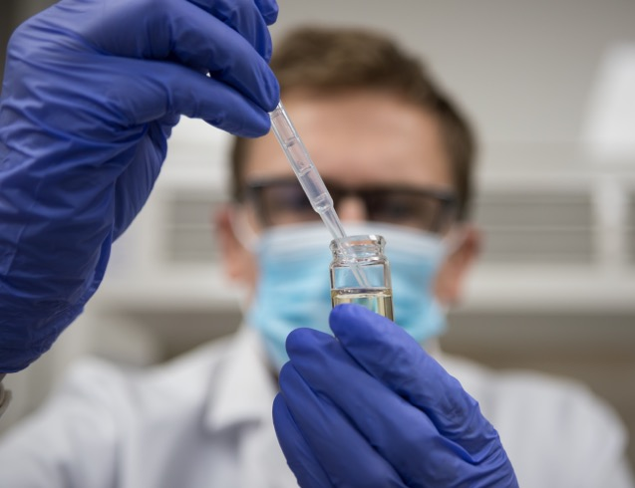
Our Heroes
Are there other heroes that you can think of?
Discuss these heroes in class and have a think about who you’d like to design on your stamp.
There will be eight different stamps in the set, so please consider a range of heroes to honour.

Slide 10
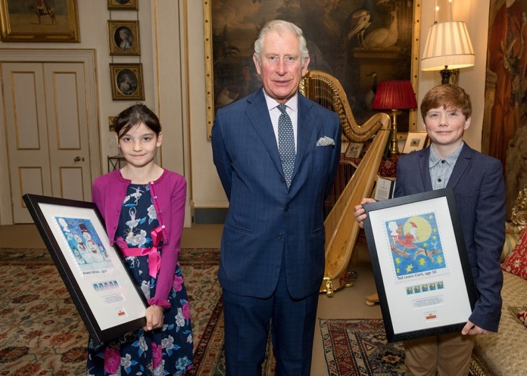
You Can Make History
Eight school children will become part of the history of Royal Mail and of the UK this year.
The winners will become the designers of stamps that will appear on millions of parcels and letters.
They will follow in the footsteps of Arwen Wilson and Ted Lewis-Clark, the winners of the last children’s stamp design competition in 2017.
One of the designs could be yours!

Slide 11
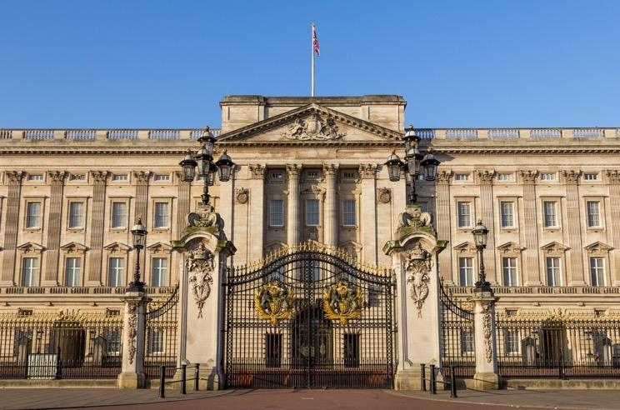
Approved by Her Majesty the Queen
Her Majesty The Queen will approve the winning stamp designs before they are printed and issued.
There are 120 great prizes on offer for area winners and runners up.
Plus, cash prizes for the winning schools too.

Slide 12
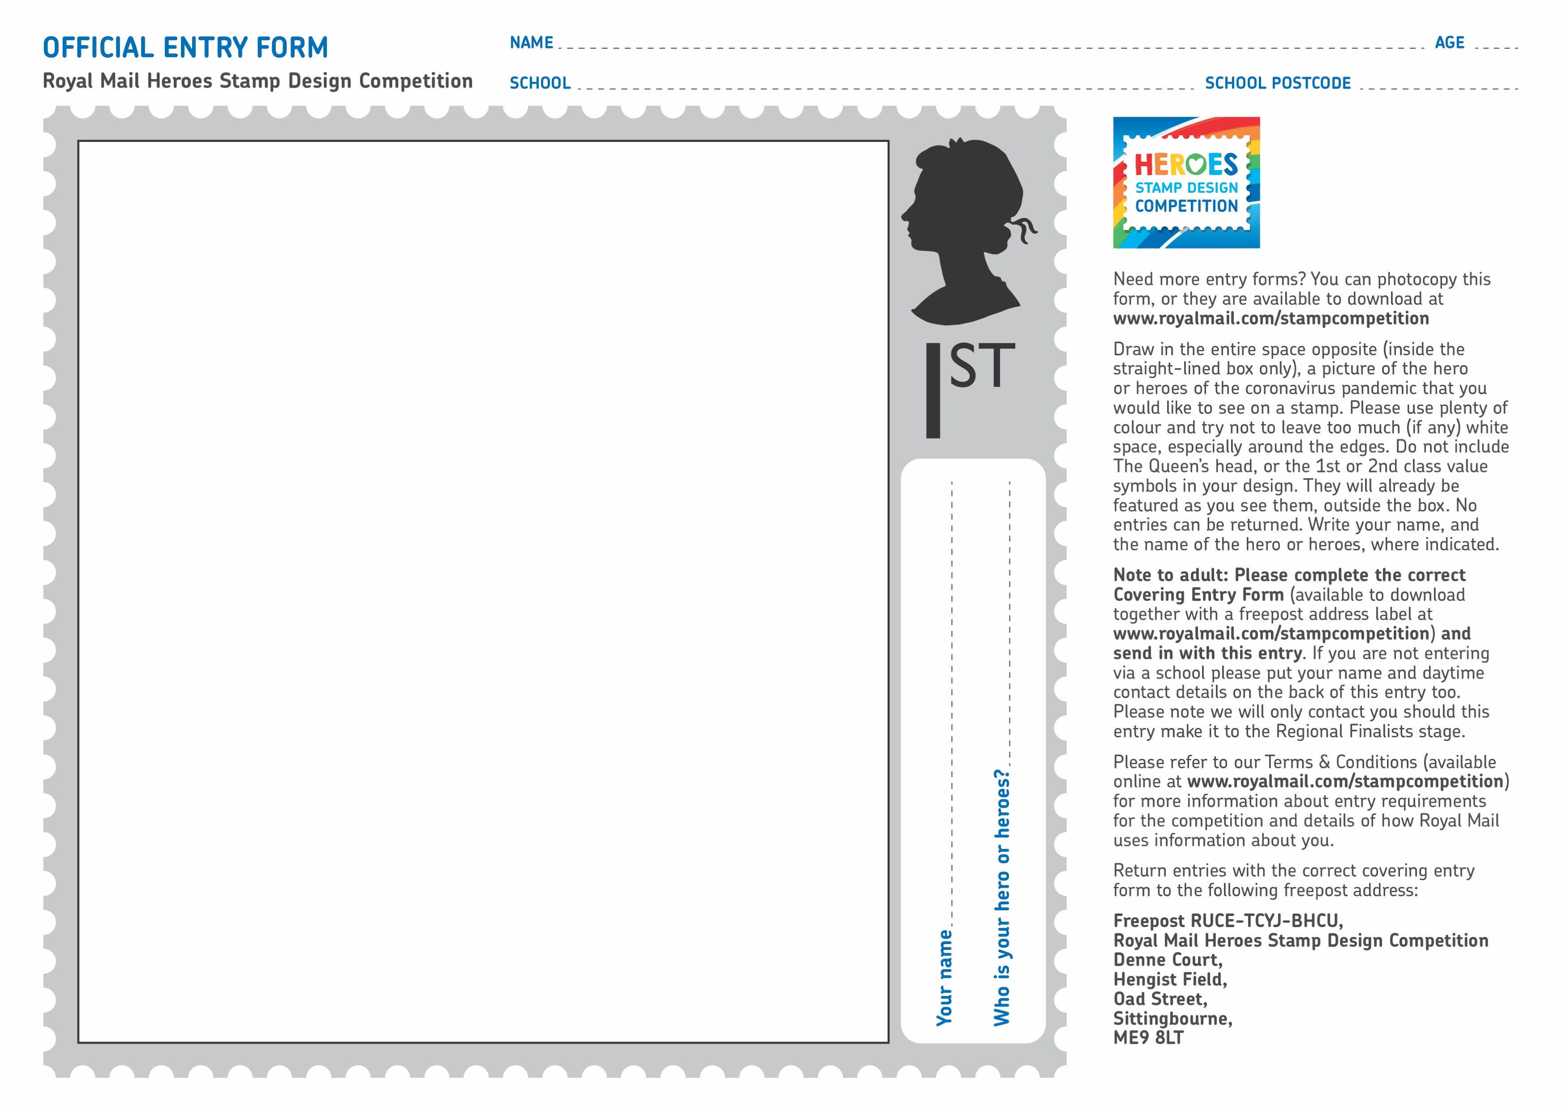
Your stamp design
Here’s what you need to do next:-
Have a think about who your hero/heroes of the coronavirus pandemic are and ask your teacher, or parent, for one of the official entry forms. You’re then ready to start designing!
Your design must be your own original work.
Drawings must be flat, so please don’t stick any materials or textures to your design and please use plenty of colour.

Slide 13
Your teacher will be able to run through some of the other important entry conditions, to ensure you create the best stamp design as possible.
The closing date for the competition is Friday 28th May 2021.
We can’t wait to see all of the amazing designs from talented children across the country.
Good Luck!

Slide 14
Thank you

