Slide 1
Newburgh Primary School

Slide 2
Newburgh Primary School Values
Nurturing
Engaged
Welcoming to everyone
Be considerate
Unique
Resilient
Great achievers
Happy and Healthy

Slide 3
THE IMPORTANCE OF

Slide 5
The Importance of Struggle
https://www.youcubed.org/resources/excerpt-of-jo-from-the-importance-of-struggle/

Slide 6
Is there such a thing as a ‘maths’ person?
https://www.youcubed.org/resources/many-ways-see-mathematics-video/

Slide 7
Myths about Maths!

Slide 8
Myths about Maths!

Slide 9
Maths is so much more than school, tests, exams…
Maths can and has changed the world!

Slide 10
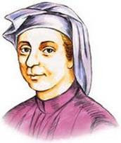
Mathematicians who Changed the World
Leonardo Fibonacci Most famous for the Fibonacci sequence.
1, 1, 2, 3, 5, 8…

Slide 11
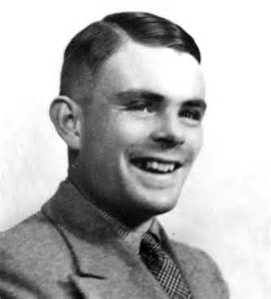
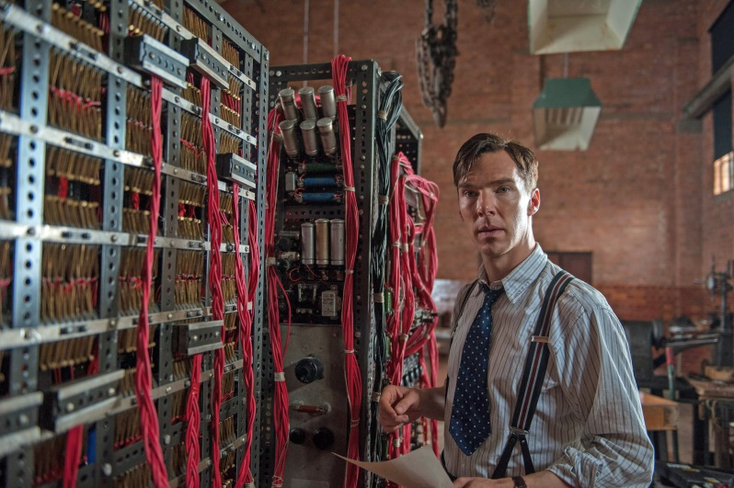
Mathematicians who Changed the World
Alan Turing – Computer Scientist & Cryptanalyst
Famous for helping to design the Bombe, which cracked the Enigma code. Shortened WWII by 4 years.

Slide 12
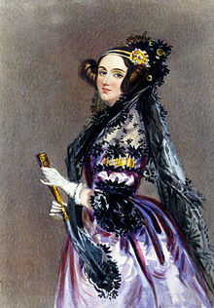
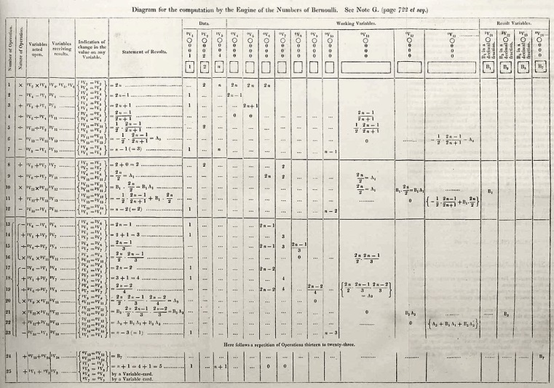
Mathematicians who Changed the World
Ada Lovelace – World’s First Computer Programmer
A writer and a mathematician
Translation program

Slide 13
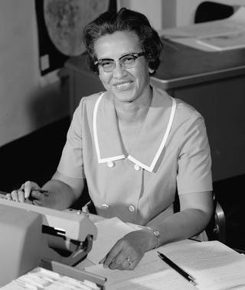
Mathematicians who Changed the World
Katherine Johnson loved maths. Early in her career, she was called a “computer.” She helped NASA put an astronaut into orbit around Earth. And then she helped put a man on the Moon.

Slide 14
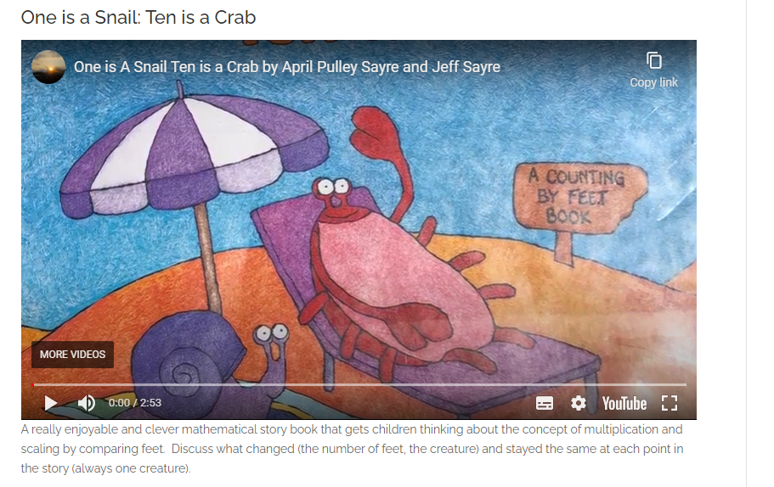
https://youtu.be/VyDTpj8uxs8

Slide 16
https://www.youtube.com/watch?v=keqYM4zfNl8

