Slide 1

Children’s Mental Health Week
1-7 February 2021
Assembly slides for primary-age children

Slide 2
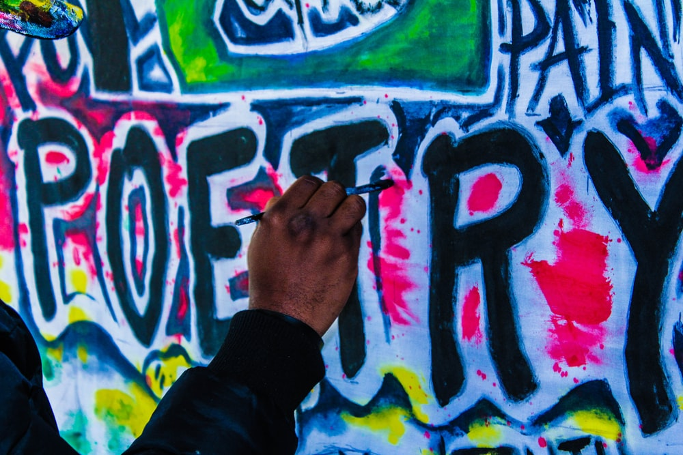
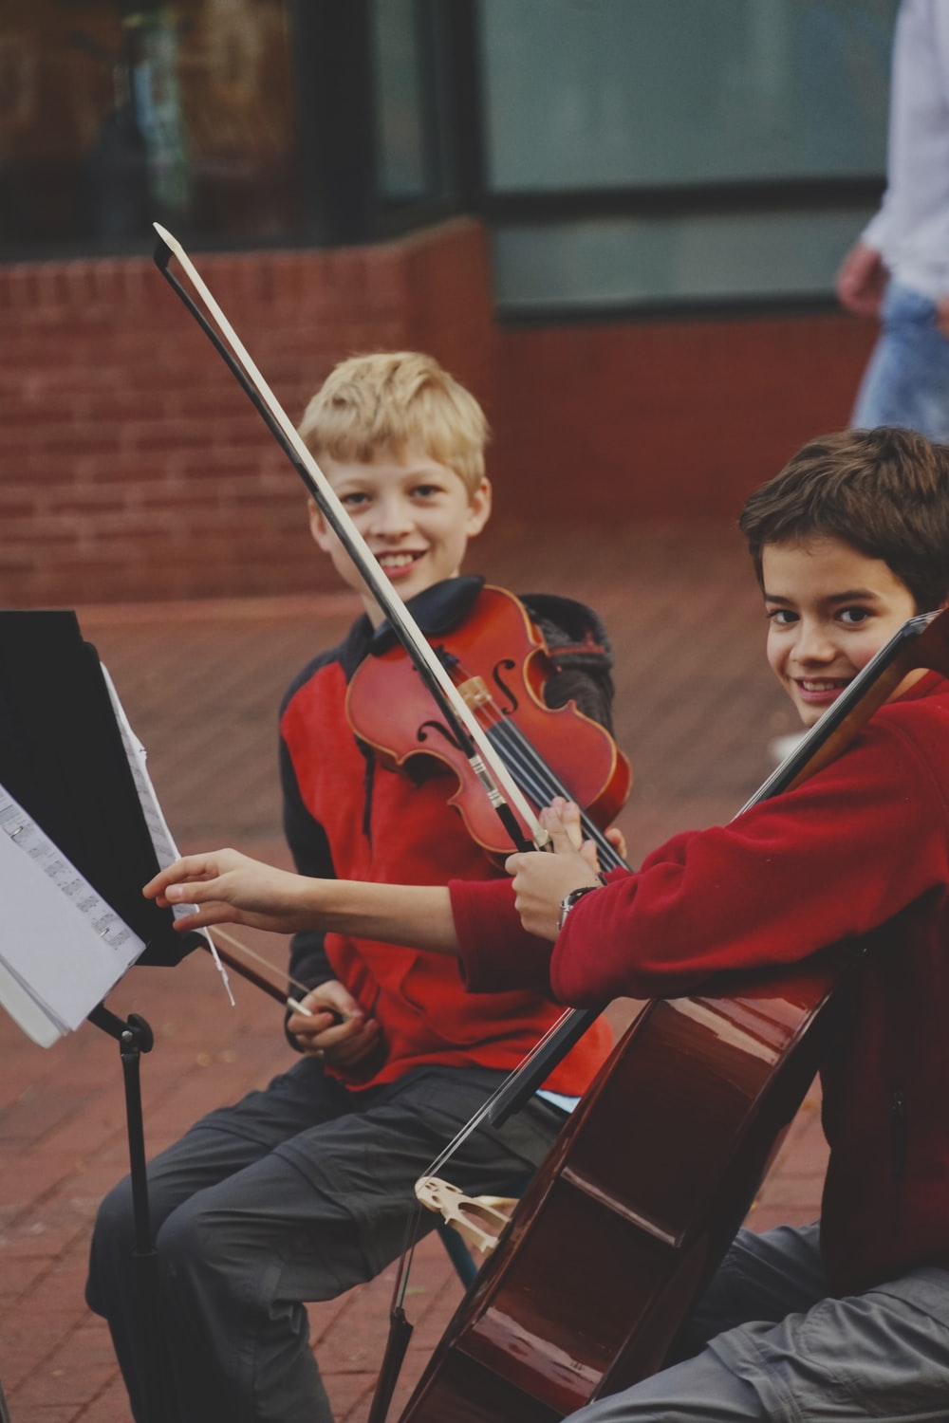
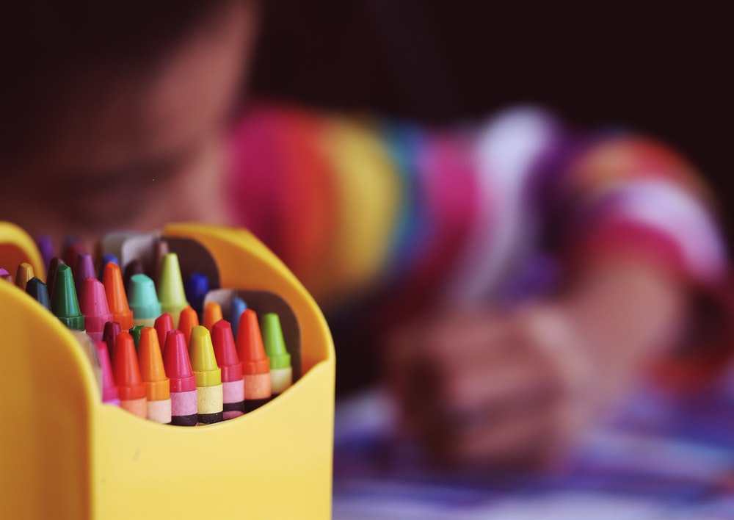
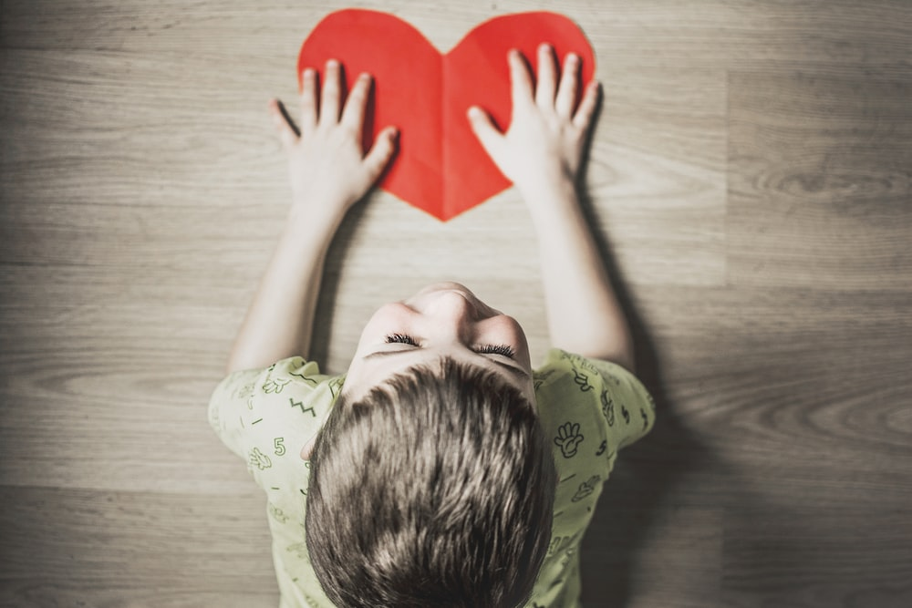
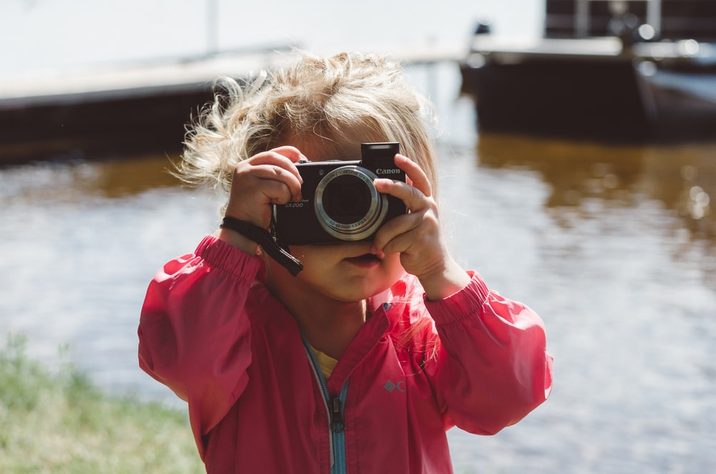
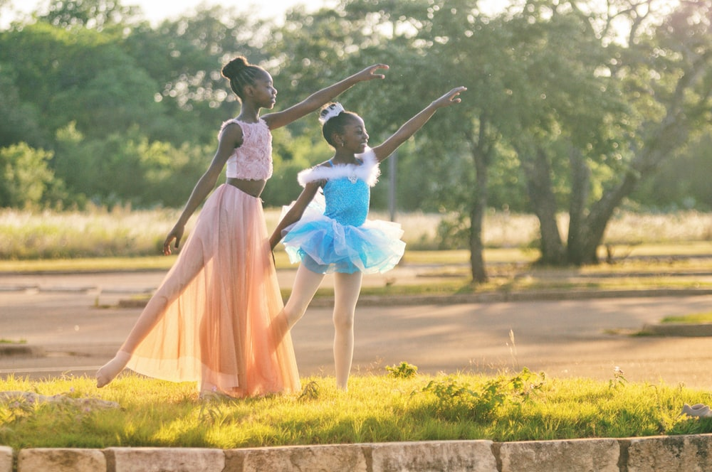
Slide 2

Slide 3
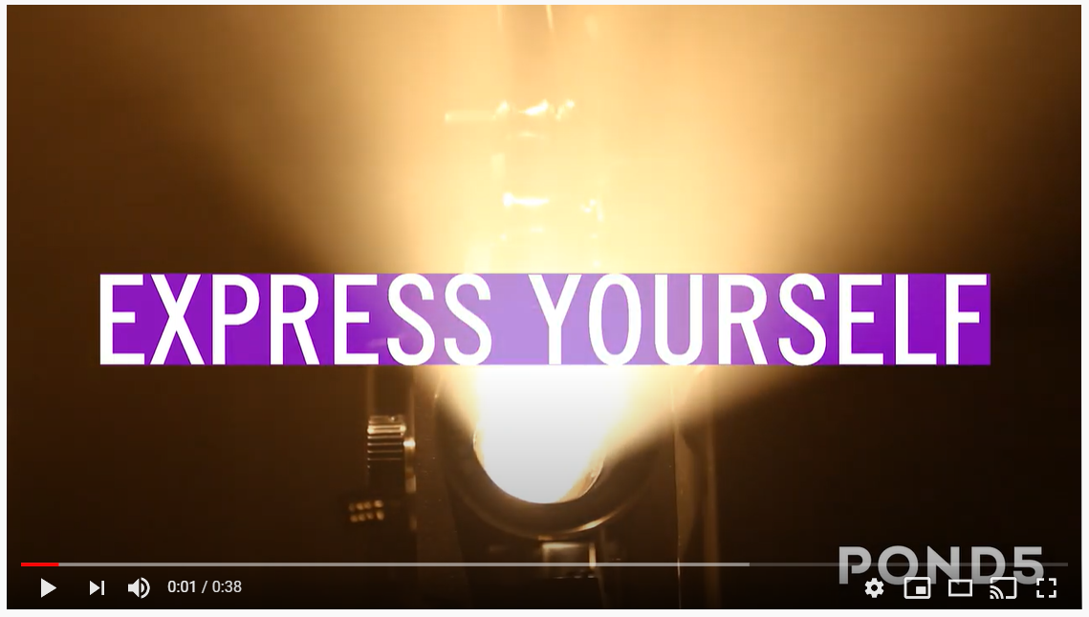
Slide 3

Slide 4
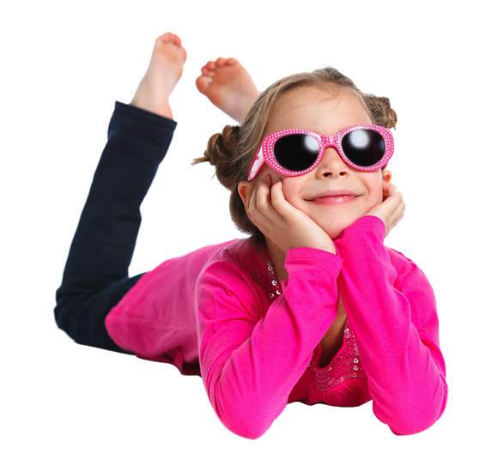
Slide 4

Slide 5

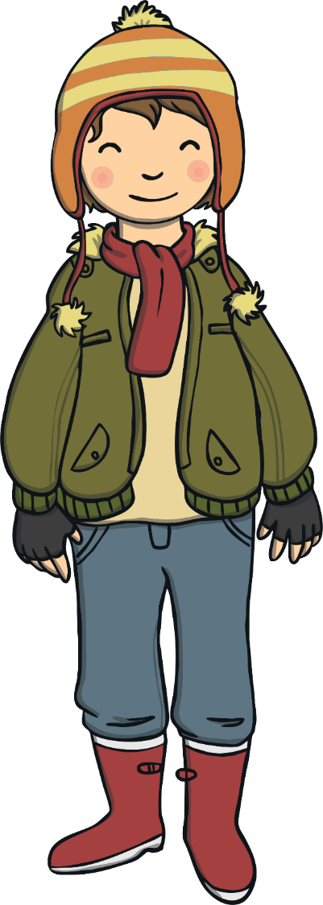
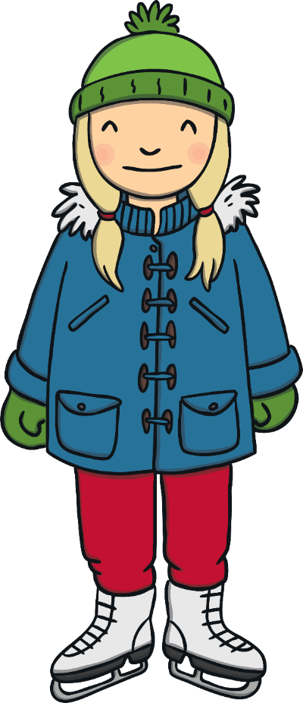
What makes
us special?
Why is it important to be kind to ourselves?

Slide 6


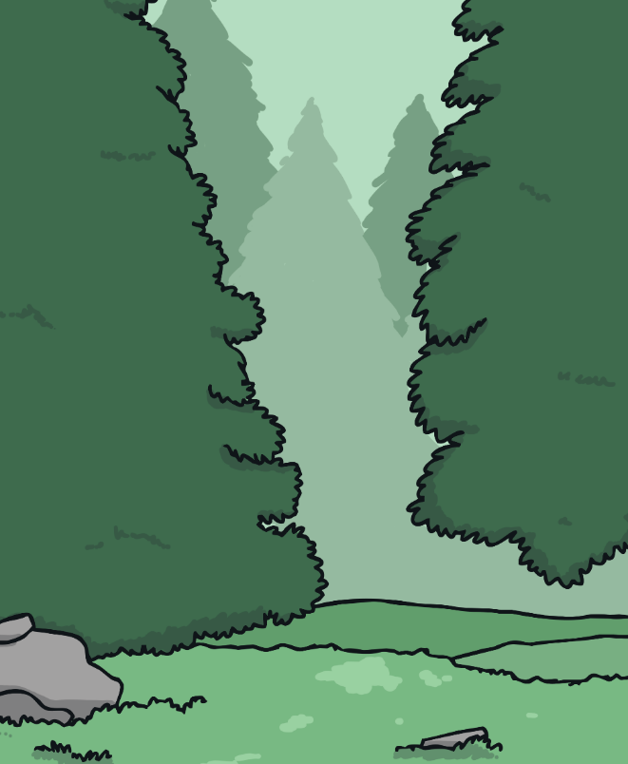
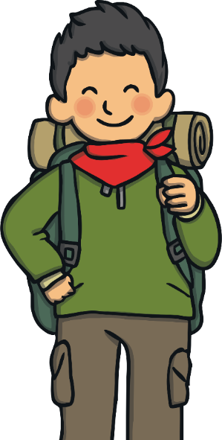
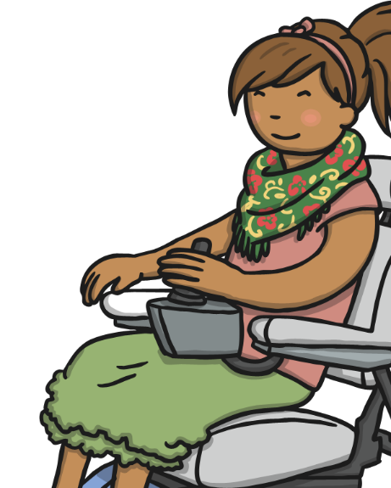
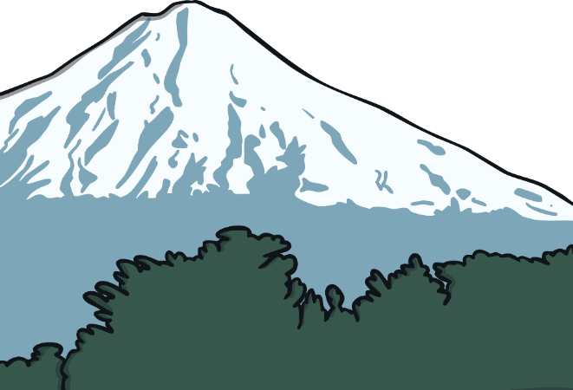
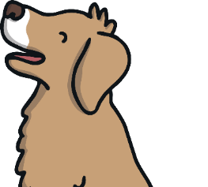
Only One Me
What a lot of fabulous things you like and are good at!
We are all individuals and this
is what makes us special.
There is only one you! This is very exciting – we can all
bring something different
and special to wherever
we are and whatever we
are doing.
None of us are exactly the same as anyone else.
We don’t need to be like anyone else, we just need to be ourselves.
Being ourselves can help us to feel happy inside.

Slide 7

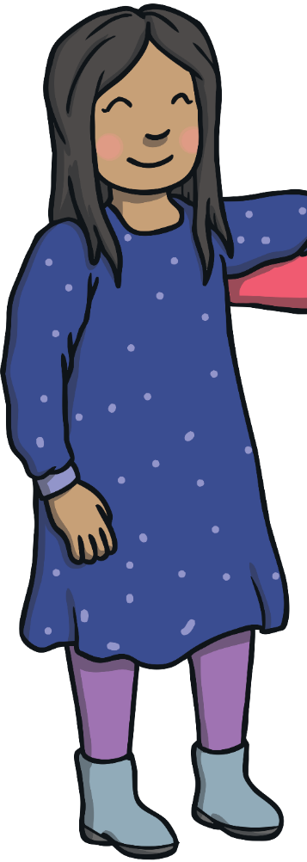
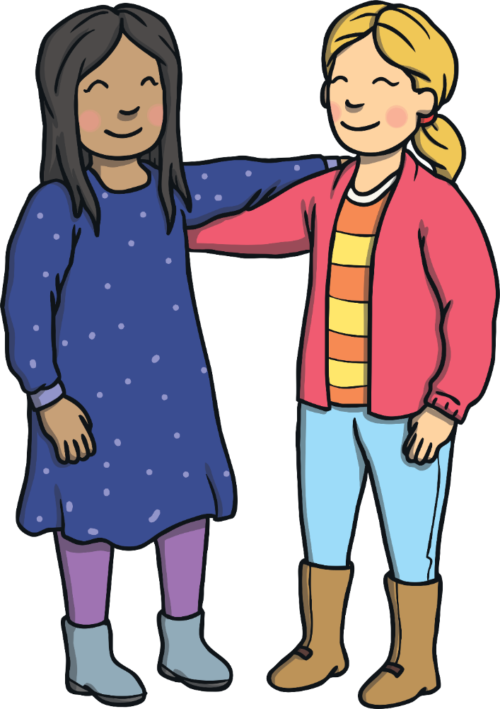
Being Kind to Ourselves
We are all special, we are all different and we are all unique!
Unique means being unlike anything or anyone else.
There can be times when we can feel different to our friends. This does not mean we need to change. Being happy to be ourselves is a way of being kind to ourselves. Not trying to be like anyone else can help us to feel happy inside.
Sit quietly and think of all the things that make you special. Nobody in this world is like you – you are totally unique!
How does that make you feel?
There are always ways for you to learn and grow but there
is so much that makes you marvellous – enjoy being you!

Slide 8

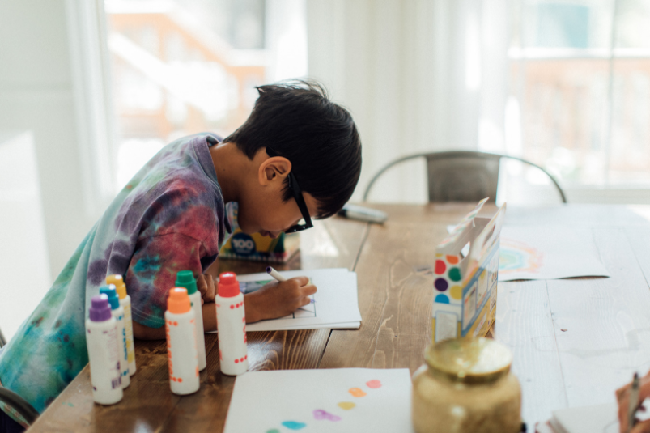
Slide 6
Listen to or read the story “Beautiful Oops”
Remember, when we express ourselves we don’t have to be a great artist or a wonderful dancer.
It’s not about being the very best at something or putting on a performance.
Let’s encourage each other to find lots of different ways to get creative and express ourselves.

Slide 9

All images in this presentation are royalty free from unsplash.com and canva.com
Beautiful Oops is by Barney Saltzberg, published by Workman Publishing https://www.youtube.com/watch?v=tjpeb6Xr1nc

