Slide 1
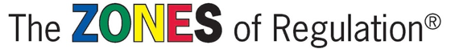

https://www.youtube.com/watch?v=xB5ceAruYrI&list=PLc03_vAS-5G4eSPaeJsTnFXUyxKLMHNso&index=8&t=0s

Slide 2
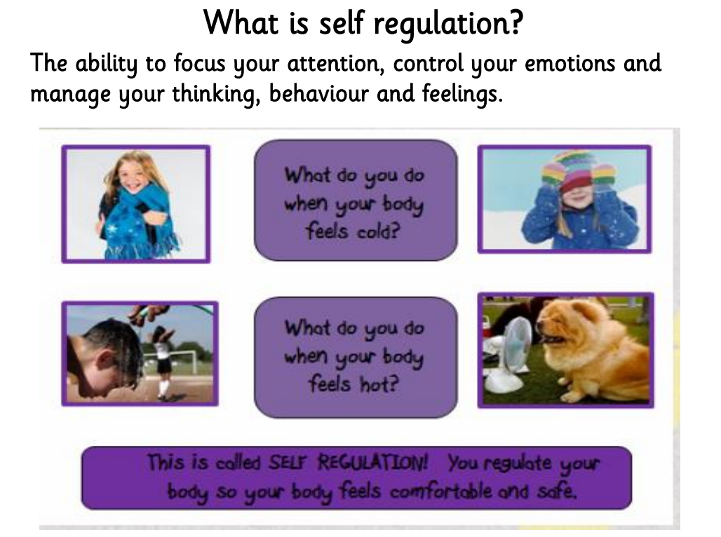

Slide 3
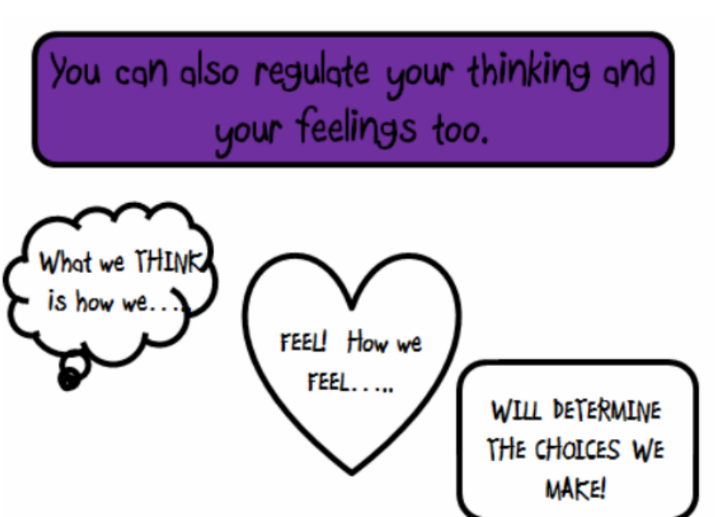
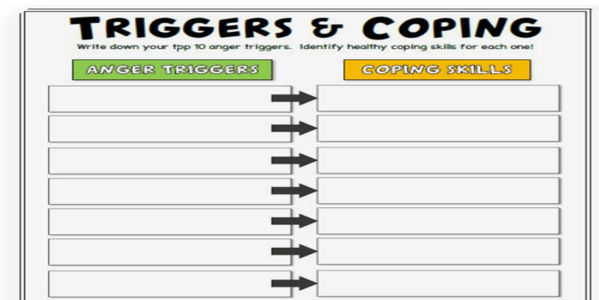
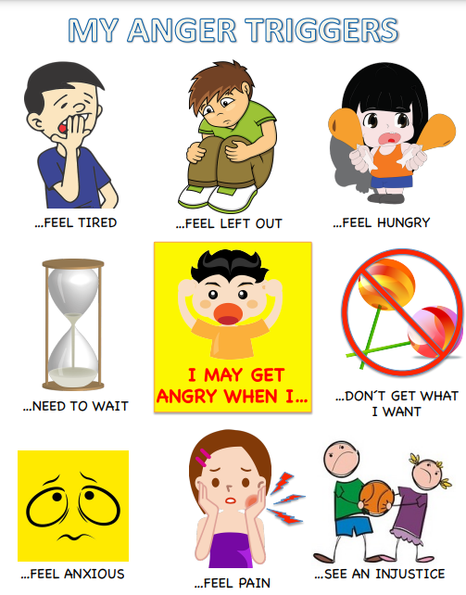

Slide 4
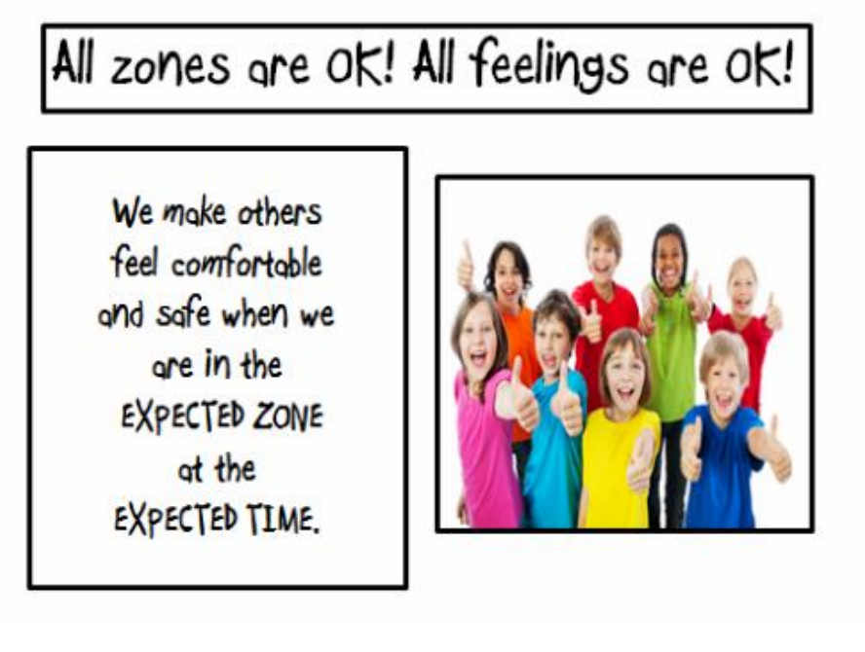
Think about the best zone for learning…

Slide 5
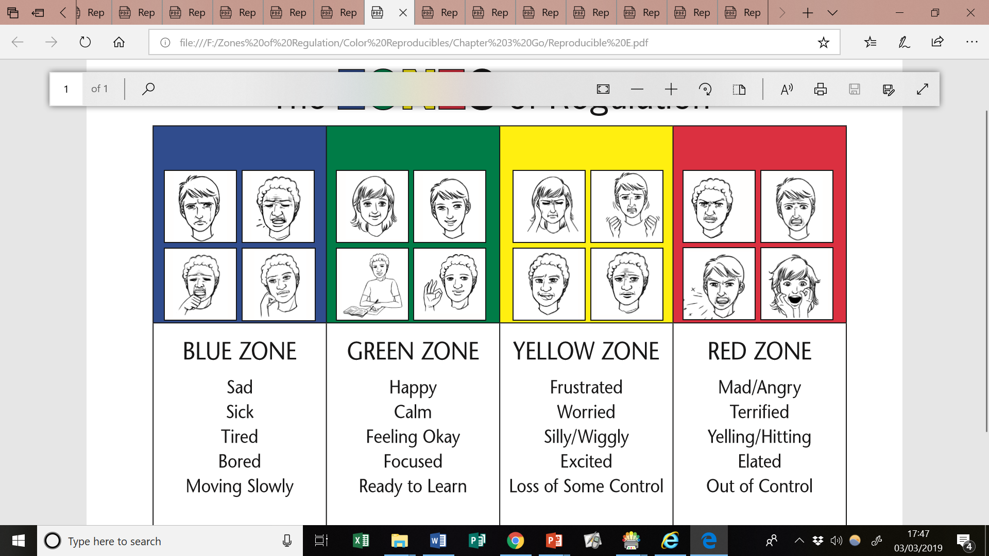
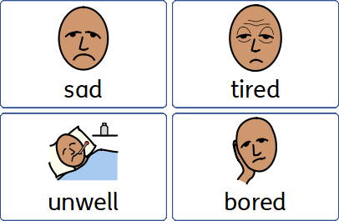
Blue Zone
Your body is running slow

Slide 6
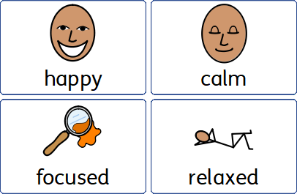
Green Zone

Slide 7
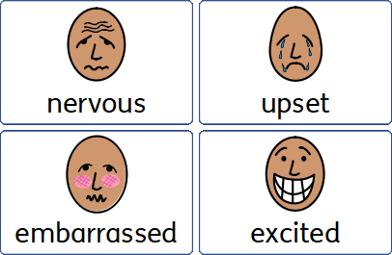
Yellow Zone

Slide 8
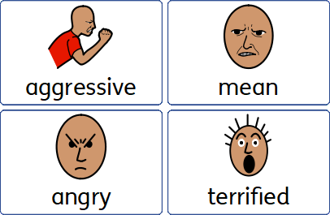
Red Zone

Slide 9



