Slide 1





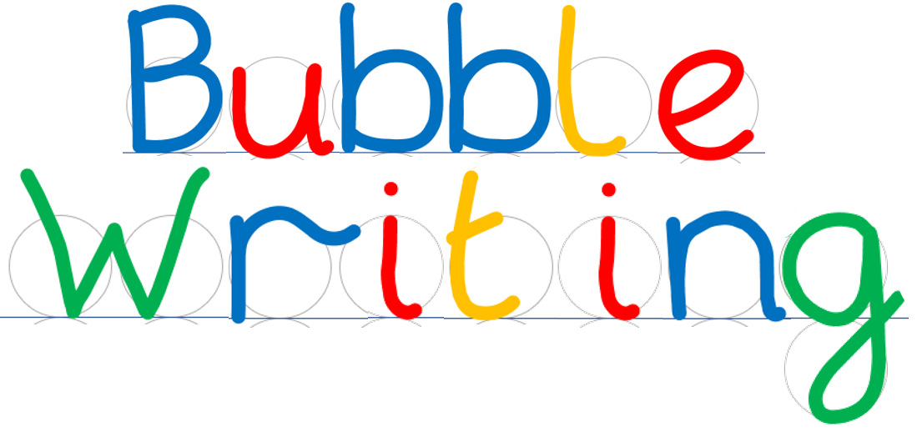
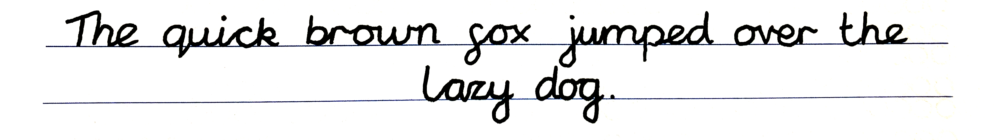
- Handwriting scaffold
©Steve Phillips 2022

Slide 2
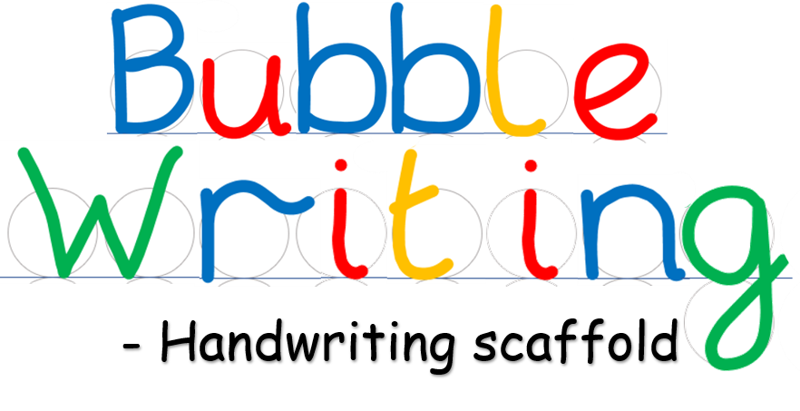





©Steve Phillips 2022

Slide 3




©Steve Phillips 2022

Slide 4




©Steve Phillips 2022

Slide 5


©Steve Phillips 2022

Slide 6



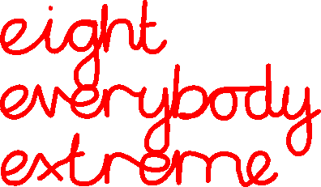
©Steve Phillips 2022

Slide 7

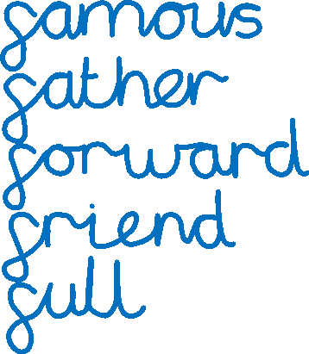
©Steve Phillips 2022

Slide 8

©Steve Phillips 2022

Slide 9

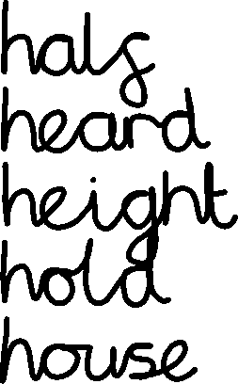
©Steve Phillips 2022

Slide 10


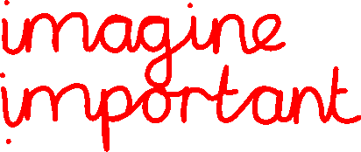



©Steve Phillips 2022

Slide 11

©Steve Phillips 2022

Slide 12




©Steve Phillips 2022

Slide 13




©Steve Phillips 2022

Slide 14





©Steve Phillips 2022

Slide 15




©Steve Phillips 2022

Slide 16





©Steve Phillips 2022

Slide 17
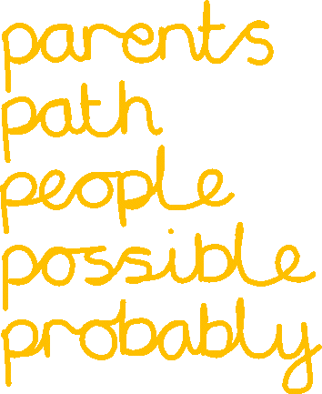

©Steve Phillips 2022

Slide 18
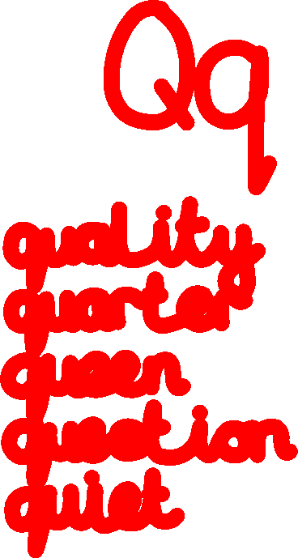
©Steve Phillips 2022

Slide 19




©Steve Phillips 2022

Slide 20





©Steve Phillips 2022

Slide 21

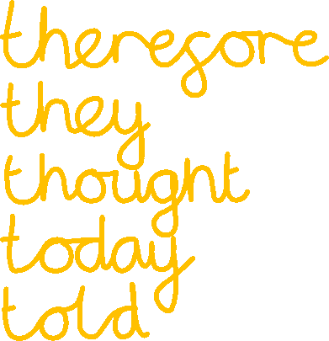
©Steve Phillips 2022

Slide 22





©Steve Phillips 2022

Slide 23




©Steve Phillips 2022

Slide 24



©Steve Phillips 2022

Slide 25
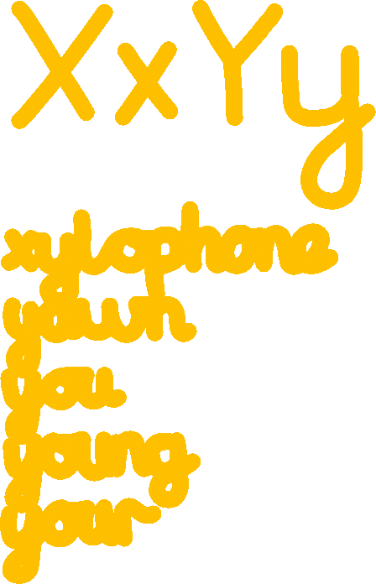
©Steve Phillips 2022

Slide 26





©Steve Phillips 2022

Slide 27
©Steve Phillips 2022

