Slide 1
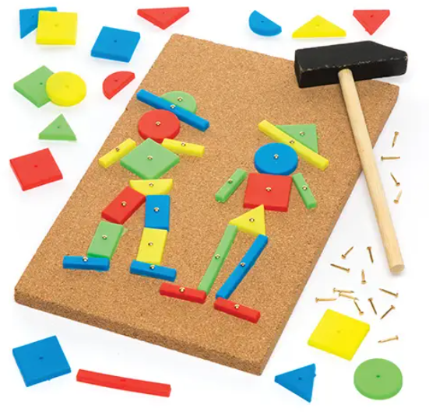
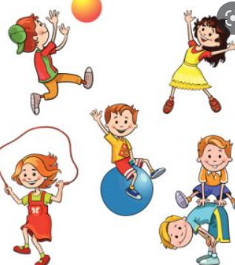
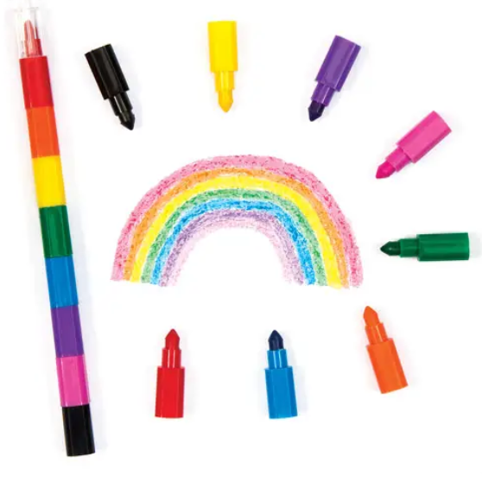
Reception Autumn Term 2: Winter Festivals
PRIME AREA: Personal, Social and Emotional Development
I can select resources in order to achieve a plan.
I can meet my own needs independently.
I can talk with others to solve conflicts.
PRIME AREA: Communication and Language
I can use longer sentences of four to six words. I can express a point of view
I can answer ‘why’ questions e.g. why did the caterpillar get so fat?
I can pay attention to more than one thing at a time.
PRIME AREA: Physical Development
I can use my core muscle strength to achieve good posture when sitting at the floor or table.
I can skip, hop, and stand on one leg and hold a pose for a game like musical statues.
I can hold a pen and pencil with a comfortable grip

Slide 2


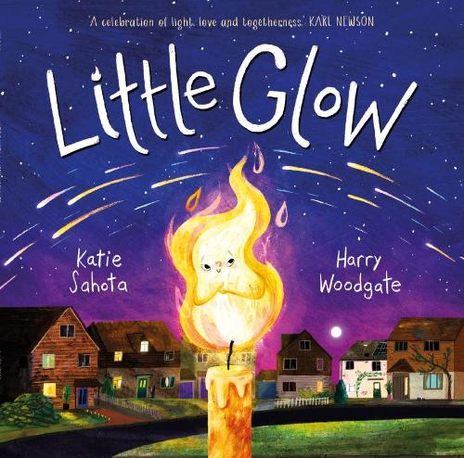
Reception Autumn Term 2: Winter Festivals
SPECIFIC AREA: Expressive Arts
I am starting to tell complex stories.
I am starting to explore and investigate different materials and manipulate them to make simple models.
I am starting to add lots of detail to my pictures.
SPECIFIC AREA: Understanding the world
I understand the effect of changing seasons in the natural world around me.
I can talk about the differences between materials and changes I notice.
I can talk about I what see, using different vocabulary.
SPECIFIC AREA: Literacy
I can take part in conversations about stories using new vocabulary.
I know that we read and write from left to right and top to bottom.
I can write some letters accurately in my independent writing.
SPECIFIC AREA: Number
I know that the last number reached when counting a small set of objects tells me how many there are in a group.
I can link numerals and amounts - showing the right number of numerals to that amount.
I can notice and correct an error in a repeating pattern.

