Slide 1
Newburgh Primary School

Slide 2
Newburgh Primary School Values
Nurturing
Engaged
Welcoming to everyone
Be considerate
Unique
Resilient
Great achievers
Happy and Healthy

Slide 3
What is air pollution?

Slide 4
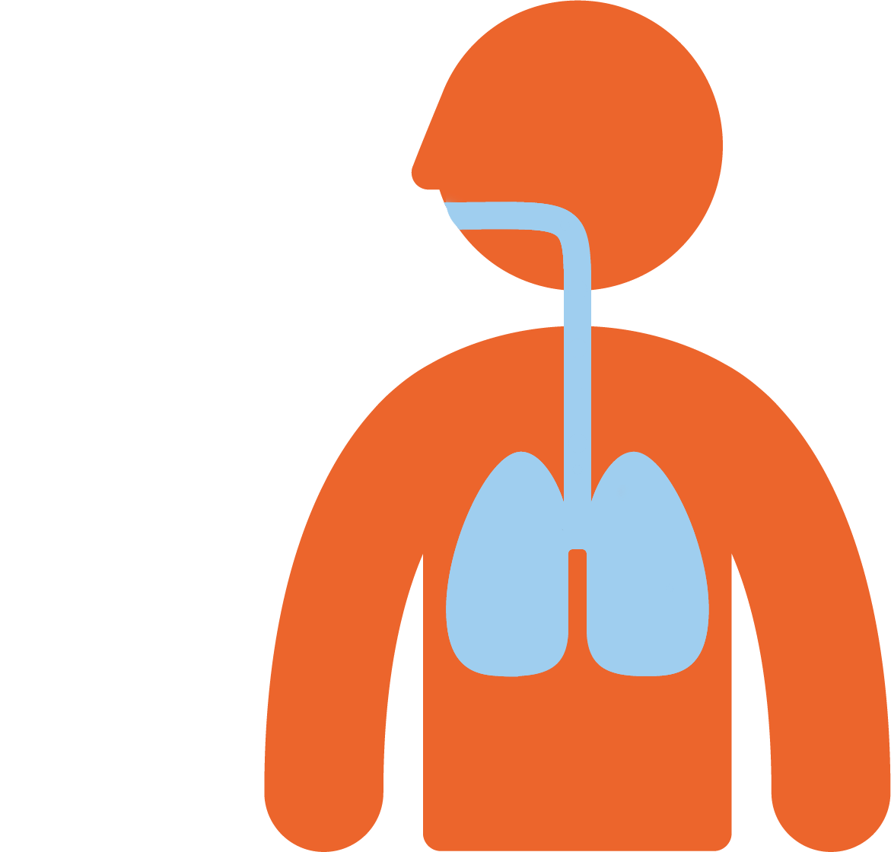
Air pollution is in the air that we breathe in.
The particles and gases enter our bodies and can damage our health.

Slide 5
Any amount of pollution can be damaging to our health, but the more that you are exposed to, the bigger the risk and the larger the impact it can have.

Slide 6
Where does air pollution come from?

Slide 7
How does air pollution affect us?
Air pollution can damage your lungs and impact your breathing.
Exposure to air pollution can cause asthma, or make symptoms of asthma worse.
Breathing air pollution can impact your heart and cause future heart problems.
But we can fix it!

Slide 8
Source | Head
Health effect | Shoulders
Solution | Knees

Slide 9
Cars

Slide 10
Making asthma symptoms worse

Slide 11
Avoid heavy traffic

Slide 12
Burning wood and coal at home

Slide 13
Vans

Slide 14
Cycling or walking

Slide 15
Impact heart and lead to future heart problems

Slide 16
Strong smelling sprays and toiletries
Notes:
e.g. spray deoderant

Slide 17
Open windows when cooking and cleaning

Slide 18
Walk instead of driving

Slide 19
Electric car

Slide 20
Leaving the engine running

Slide 21
Strong smelling cleaning products

Slide 22
More coughing

Slide 23
Damage lungs and impact breathing

Slide 24
Take quiet routes and avoid main roads

Slide 25
So what can you and your family do to play your part?
Outdoor air pollution
Walk, cycle, scoot or take public transport whenever you can instead of driving
Discover the side streets – use quieter streets and avoid main roads
Go electric – ask your parents to think about making their next car an electric one!
Don’t idle – ask your parents to turn off their engines when the car isn’t moving

Slide 26
Indoor air pollution
Open windows to let the fresh air in – especially when
cooking
or cleaning
Use fragrance-free milder cleaning products.
Ask your parents to only burn dry, well-seasoned wood or smokeless fuel on your stove, open fire or barbeque.

