Slide 1





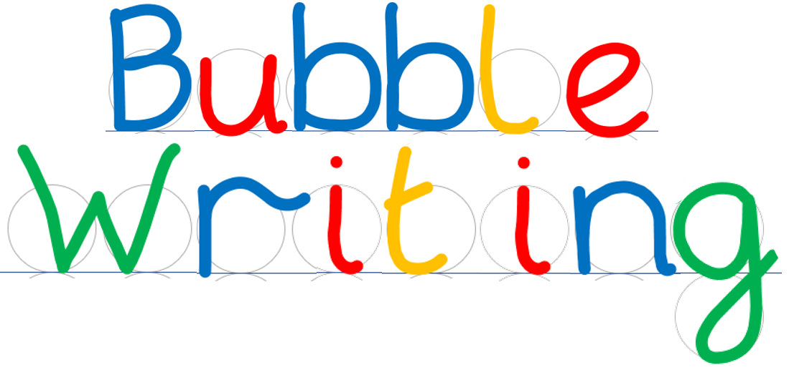
- Handwriting scaffold
©Steve Phillips 2022

Slide 2
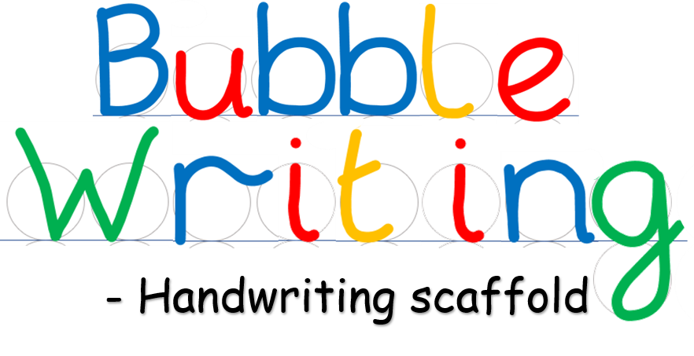






©Steve Phillips 2022

Slide 3






©Steve Phillips 2022

Slide 4





©Steve Phillips 2022

Slide 5


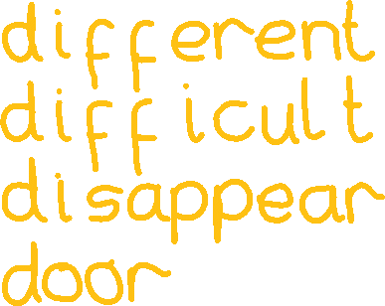
©Steve Phillips 2022

Slide 6
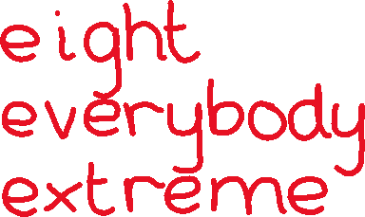


©Steve Phillips 2022

Slide 7

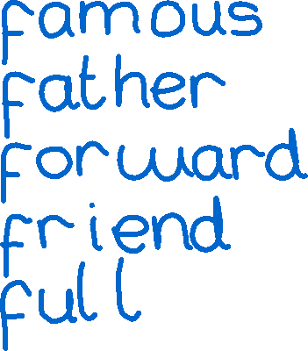
©Steve Phillips 2022

Slide 8

©Steve Phillips 2022

Slide 9


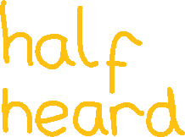

©Steve Phillips 2022

Slide 10




©Steve Phillips 2022

Slide 11
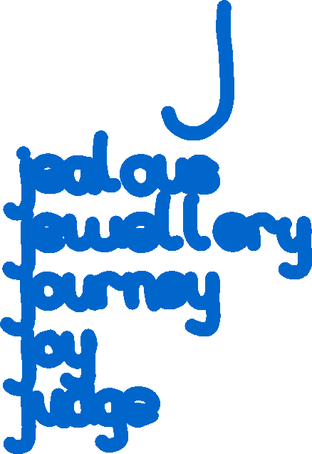
©Steve Phillips 2022

Slide 12












©Steve Phillips 2022

Slide 13


©Steve Phillips 2022

Slide 14






©Steve Phillips 2022

Slide 15




©Steve Phillips 2022

Slide 16






©Steve Phillips 2022

Slide 17
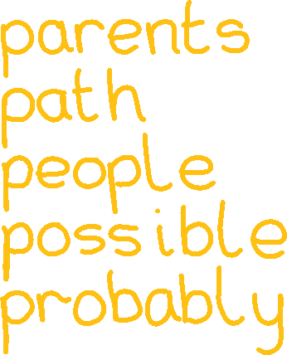
©Steve Phillips 2022

Slide 18
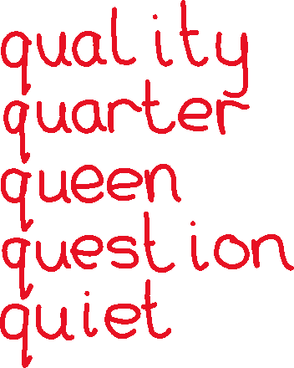
©Steve Phillips 2022

Slide 19
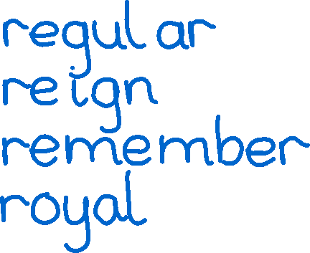

©Steve Phillips 2022

Slide 20





©Steve Phillips 2022

Slide 21
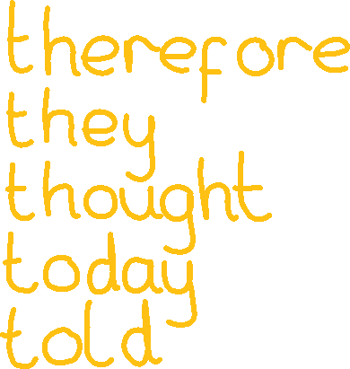
©Steve Phillips 2022

Slide 22




©Steve Phillips 2022

Slide 23
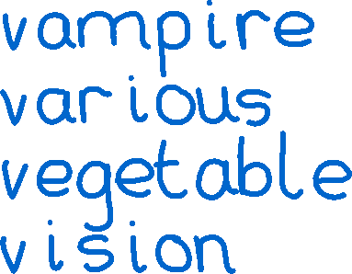

©Steve Phillips 2022

Slide 24


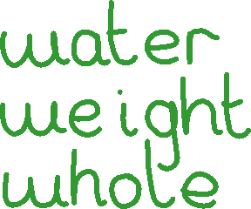


©Steve Phillips 2022

Slide 25
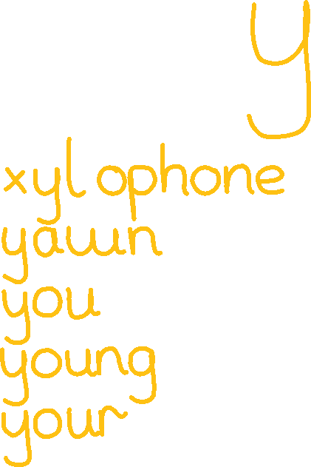
©Steve Phillips 2022

Slide 26




©Steve Phillips 2022

Slide 27
©Steve Phillips 2022

