Slide 1





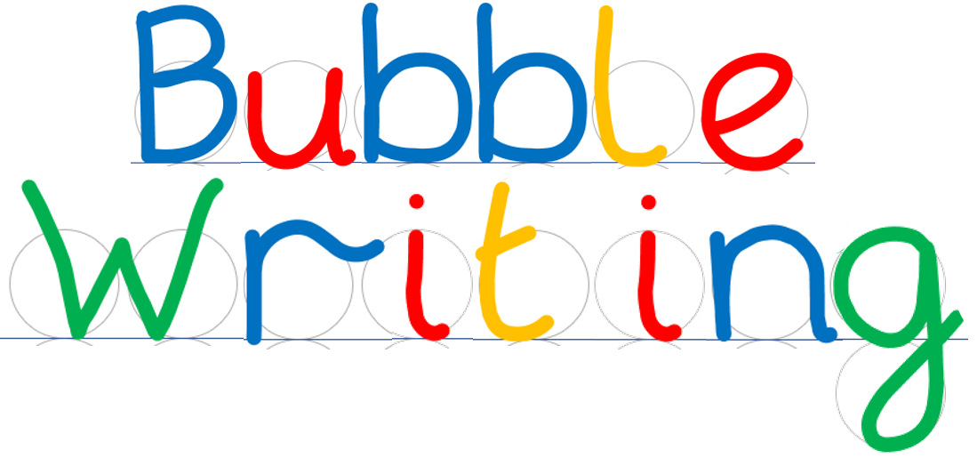
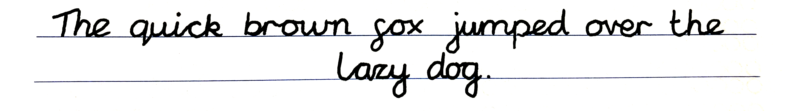
- Handwriting scaffold
©Steve Phillips 2022

Slide 2
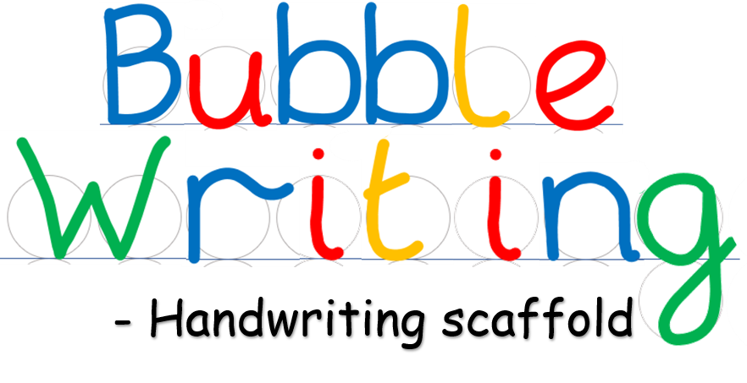


©Steve Phillips 2022

Slide 3

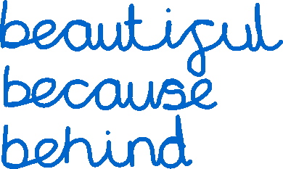

©Steve Phillips 2022

Slide 4

©Steve Phillips 2022

Slide 5


©Steve Phillips 2022

Slide 6


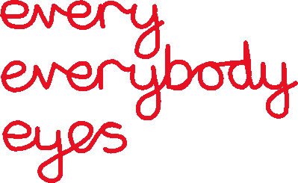
©Steve Phillips 2022

Slide 7

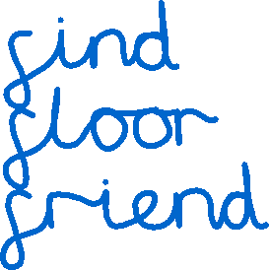
©Steve Phillips 2022

Slide 8

©Steve Phillips 2022

Slide 9



©Steve Phillips 2022

Slide 10




©Steve Phillips 2022

Slide 11
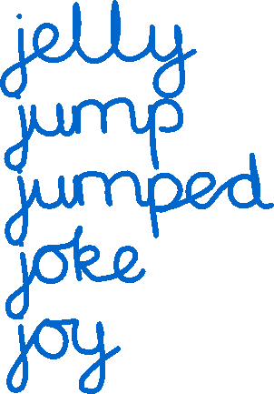
©Steve Phillips 2022

Slide 12

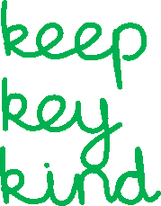
©Steve Phillips 2022

Slide 13


©Steve Phillips 2022

Slide 14


©Steve Phillips 2022

Slide 15





©Steve Phillips 2022

Slide 16




©Steve Phillips 2022

Slide 17
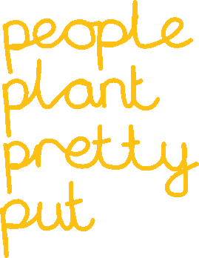
©Steve Phillips 2022

Slide 18

©Steve Phillips 2022

Slide 19



©Steve Phillips 2022

Slide 20




©Steve Phillips 2022

Slide 21



©Steve Phillips 2022

Slide 22


©Steve Phillips 2022

Slide 23




©Steve Phillips 2022

Slide 24






©Steve Phillips 2022

Slide 25


©Steve Phillips 2022

Slide 26


©Steve Phillips 2022

Slide 27
©Steve Phillips 2022

