Slide 1
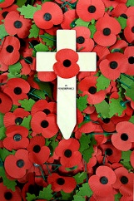
Remembrance
KS1

Slide 2
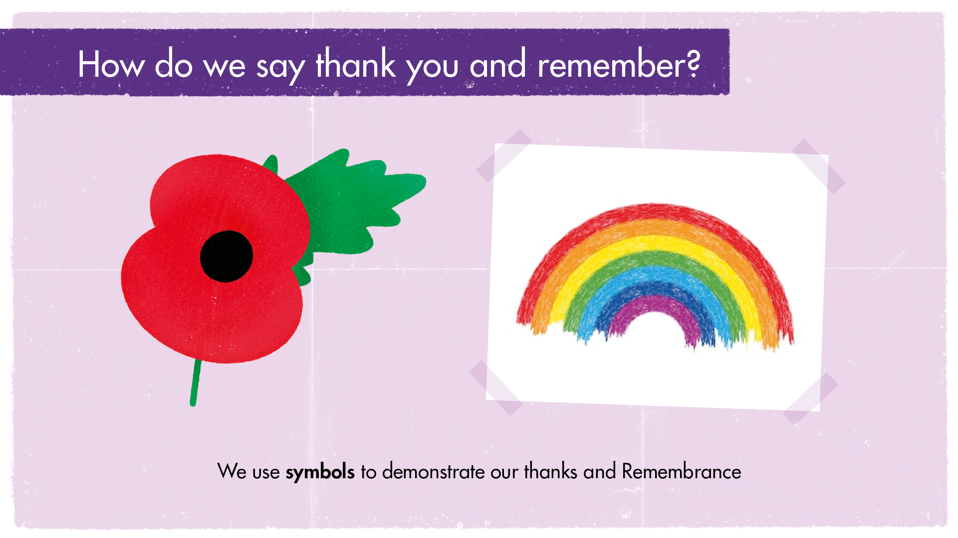
Notes:
Put your hands up if you have ever worn a poppy (you may be wearing one now!). Put your hands up if you have ever drawn a rainbow to hang in your window to thank key workers for helping us.
We often use symbols to represent our thoughts about something.
During Remembrance we wear poppies. The poppy was chosen because at the end of the First World War poppies began to grow in the fields where the fighting happened. People wear a poppy to show their respect to those that gave their lives and as a symbol of hope for a peaceful future.
During the pandemic, people put pictures of rainbows in their windows to show support and thanks to key workers and as a symbol of hope that things will get better.
These symbols remind us to take time to remember and thank all the people who gave in service and sacrifice
Further discussion if time or for later review: do children know of any other symbols that represent something important? Perhaps they could create one themselves that represents how they feel about an important issue or loved one?

Slide 3
Poppy Animation
https://www.youtube.com/watch?v=pv_ub7Be7oA

Slide 4
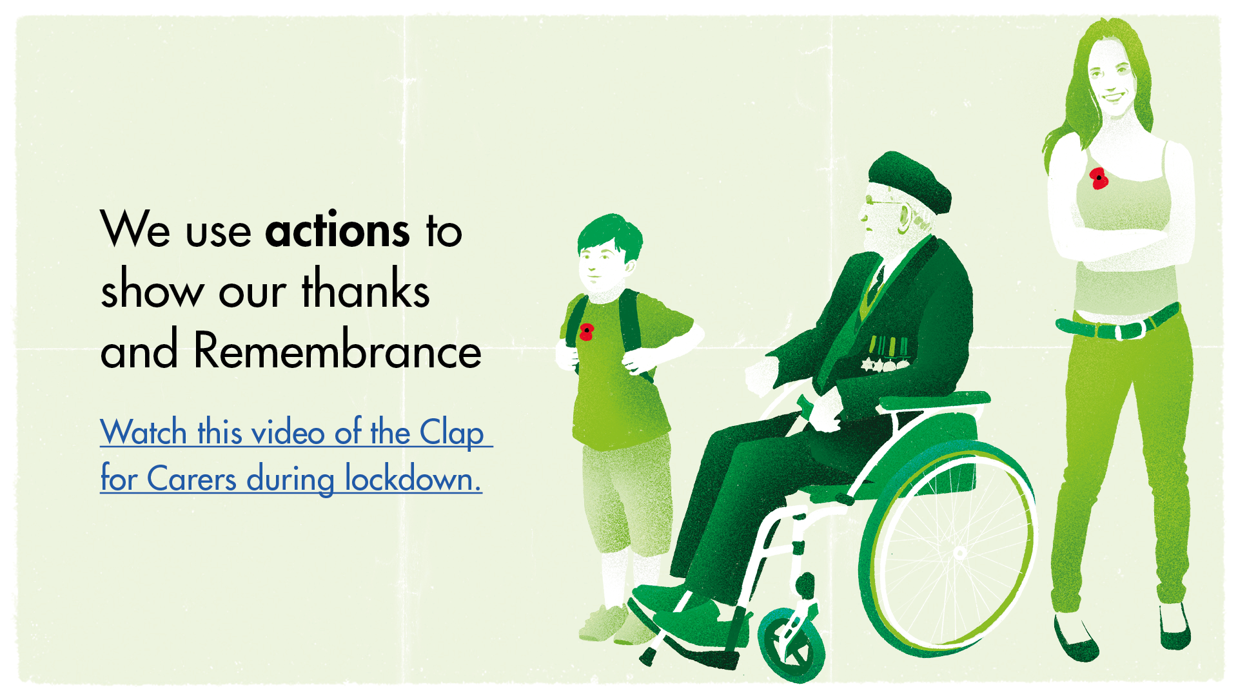
Notes:
Put your hands up if you have ever participated in a minute’s silence.
Put your hands up if you have joined in with a Clap for our carers.
We use actions to demonstrate our thanks and remembrance too. We hold a two minute’s silence on Remembrance Sunday to remember all those who died so our thoughts can focus fully on thinking about them and the sacrifice they made of giving their lives to fight and defend our freedoms.
The ‘Clap for Carers’ was started at the beginning of lockdown with members of the public applauding from their doorsteps and windows every Thursday at 8pm to thank NHS staff, supermarket workers, teachers and other frontline helpers who were so important in the fight against Covid-19.
These actions helps us take time to remember the service and sacrifice of others.

Slide 5
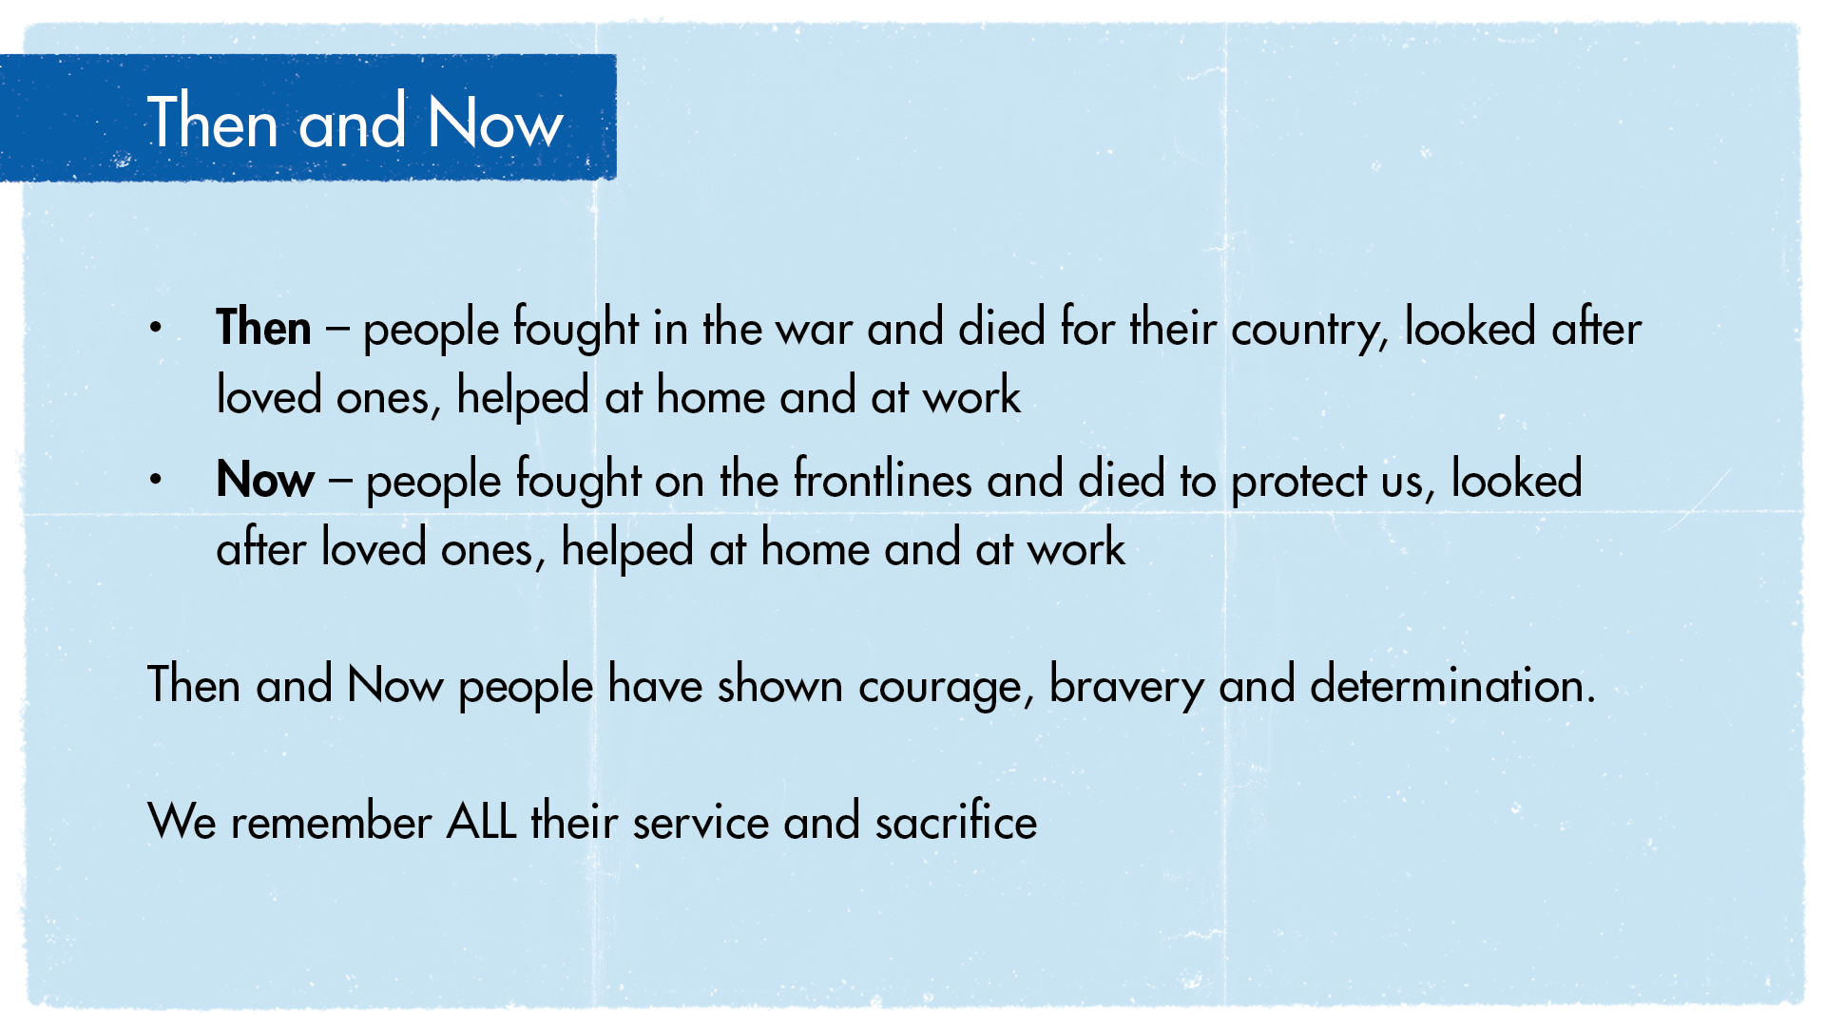
Notes:
Remind children that it is with the service and sacrifice of others that we won the Second World War.
Remind children that it is with the service and sacrifice of others that we will overcome the Coronavirus.
The experiences of people in the Second World War and our experiences today reminds us of the importance of being brave and helping others.
It is important to think about this so we can understand why we remember.

Slide 6
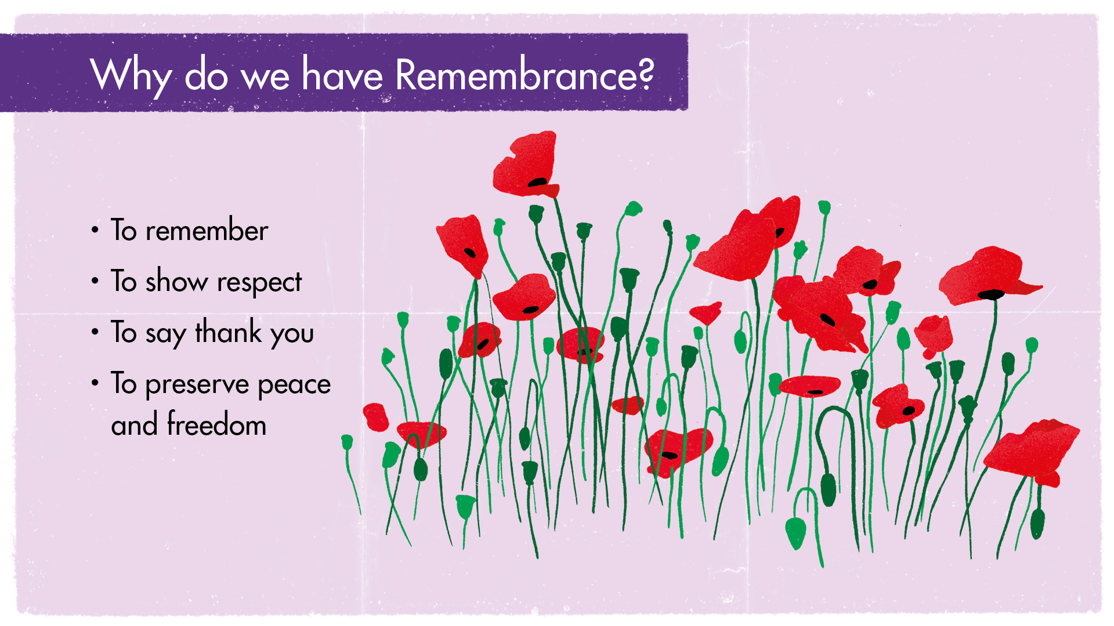
Notes:
All those who served and sacrificed deserve to be remembered and thanked for what they have done, then and now. We must not ever forget that without their service and sacrifice, our world would be very different and we may not have many of the freedoms and the safety we enjoy today.
Can you imagine what might have happened if people had not given in service and sacrifice?
Examples might be:
Then –people might have starved as they didn’t have enough food, more people would have died, there might not have been enough soldiers to fight, we might not have won the war
Now – people who were shielding might not have had enough food, the hospitals might have become too full, more people might have caught the virus, more people would have died
Can you think about what Remembrance means to you?
Everyone will have their own view and experience of what Remembrance means. Children may have family members who serve in the Armed forces today, or perhaps work on the frontline of the pandemic, such as NHS staff. How do they feel about remembrance now?
Who are you grateful to and who would you like to thank this Remembrance Day?

